Slide 1

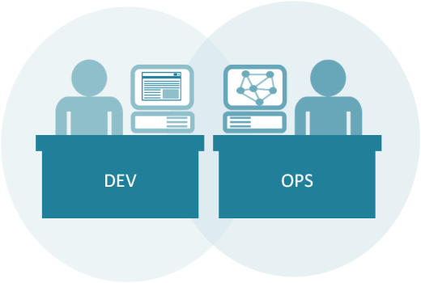
Microservices Engineering Boot Camp
64600M_3.0_2018

Slide 2
Welcome!
Logistics (breaks, facilities, lunch, etc.)
Rules of Engagement
Introductions
Let’s Get Started!
Notes:
Resources for running Kubernetes & practicing Microservices on a Microsoft cloud:
https://docs.microsoft.com/en-us/azure/container-service/kubernetes/container-service-kubernetes-windows-walkthrough
https://hackernoon.com/kubernetes-adventures-on-azure-part-2-windows-cluster-and-trick-for-scaling-pods-27e769edde15
A few key agenda items:
Microservice patterns – 1 service per container/per host
Database per container
Rete limiting
API Gateway
Strangler pattern
Convert monolith into Microservice
Customer model
Inventory service
Example: Spin up monolith and break it up

Slide 3

Who is your instructor today?
A little about me…

Slide 4
Introductions
What is your Name and Job Role?
Your company or team?
Expectations for the class?
Something interesting about yourself?

Slide 5
Core Objectives
Understand how to adopt, plan or improve your transition to Microservices
Navigate different tools for enabling Microservices and how to use them
Map technical practices to the business strategy behind Microservices
Get hands-on practice with tools which enable core Microservices architecture
Build more DevOps practices through Microservices adoption
Apply Microservices use cases to continuous integration, delivery and testing
Understand how to refactor monolithic systems into more modular, component-based systems

Slide 6
What to expect from this class
Flexibility
Conversations
Literacy and awareness on many of the principles, tools, and practices surrounding Microservices culture, architecture and implementation.
An effort to focus on your own situations and challenges so you can act on what you learn.

Slide 7
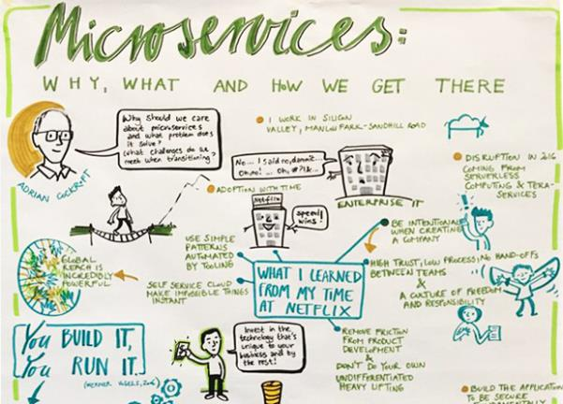
Part 1: Introduction to Microservices
Microservices is defined as a loosely-coupled, service-oriented architecture with bounded context.
Notes:
Recommended reading:
https://thenewstack.io/microservices-changed-matter/
Excerpt:
“…What works? It starts with the organization and the API: A microservices-based product team and a separate backend-based platform team with an API between them, where the API calls are made and the infrastructure responds consistently and accordingly.
Microservices is defined as a loosely-coupled, service-oriented architecture with bounded context. It allows updates without needing to understand how everything else works. Services are built across organizations, and ownership stays in one place. Microservices architecture serves more as point-to-point calls between systems. You must have flexible message formats; irrespective of the versions, everything still works. That means when building a microservices architecture, you need some tooling to configure, discover, route traffic and observe and build systems.
IBM’s Andrew Hately, distinguished engineer and chief technology officer for IBM Cloud Labs, offers the context that fifteen years ago, people might check their bank balance once a week. In time, the Internet allowed people to check their balances, and taking that accessibility further, smartphones drove, perhaps, the most change. Today, people can get instant access to every spend on their accounts. That speed and immediacy means that businesses have to respond with services that are developed on the same scale that the social networks and search companies developed their services on over the past five to ten years.

Slide 8

The journey is a “Team of Teams”
“First I needed to shift my focus from moving pieces on the board to shaping the ecosystem.”
– General S. McChrystal, Team of Teams: New Rules of Engagement for a Complex World
McChrystal (US Army General) understood that the only way to scale the agility and speed of a small team to a scope that could be employed in a hierarchical organization of many thousands of people was to employ radical transparency and independent decision-making power that was decoupled from the approval of the command structure. This “team of teams” approach reduced silos and flattened the organization, allowing much greater speed and adaptability.
Notes:
General Stanley McChrystal’s book:
https://www.amazon.com/Team-Teams-Rules-Engagement-Complex/dp/1591847486
In this book General McChrystal explains how he and his senior staff reinvented the military task force to a model of decentralized decision making in the midst of a grueling war.
McChrystal understood that the only way to scale the agility and speed of a small team to a scope that could be employed in a hierarchical organization of many thousands of people was to employ radical transparency and independent decision-making power that was decoupled from the approval of the command structure. This “team of teams” approach reduced silos and flattened the organization, allowing much greater speed and adaptability.

Slide 9
Situation: Enterprise team building an enterprise app
Lets imagine a medium sized enterprise app that has a team with roughly
12 engineers
2 project managers
2 scrum masters
3 database engineers
8 UI engineers
2 engineering managers
1 UI engineering manager
1 QA manager
1 database engineering manager
2 directors
4 QA
36 individuals total, with 1/3 partially allocated to this and other projects

Slide 10
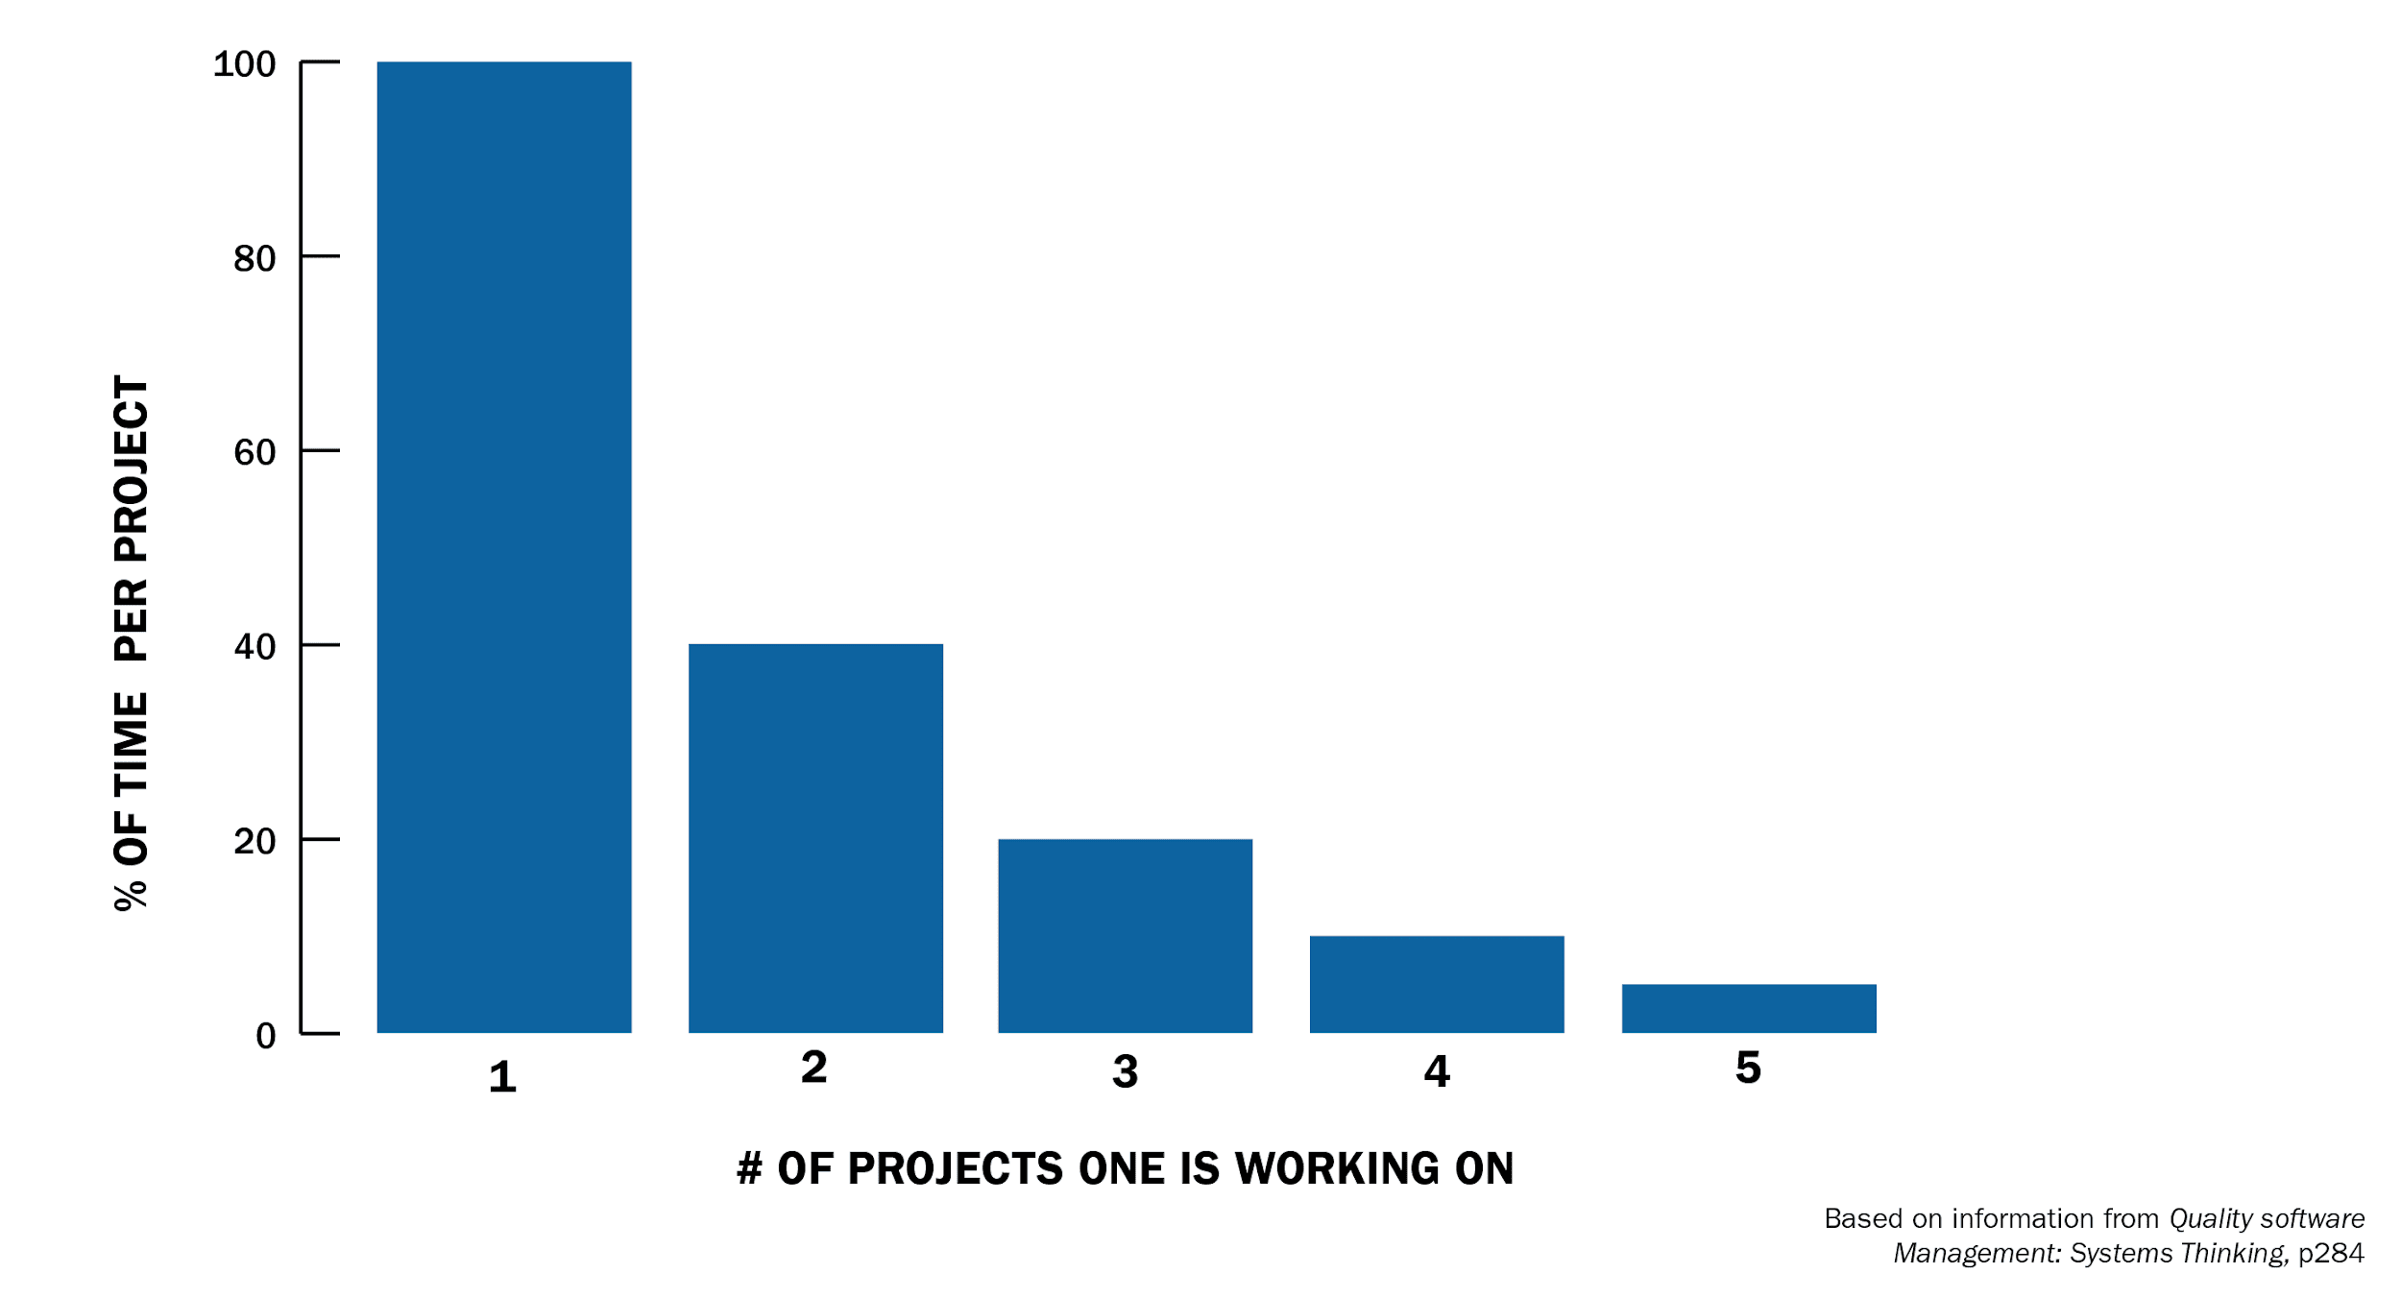
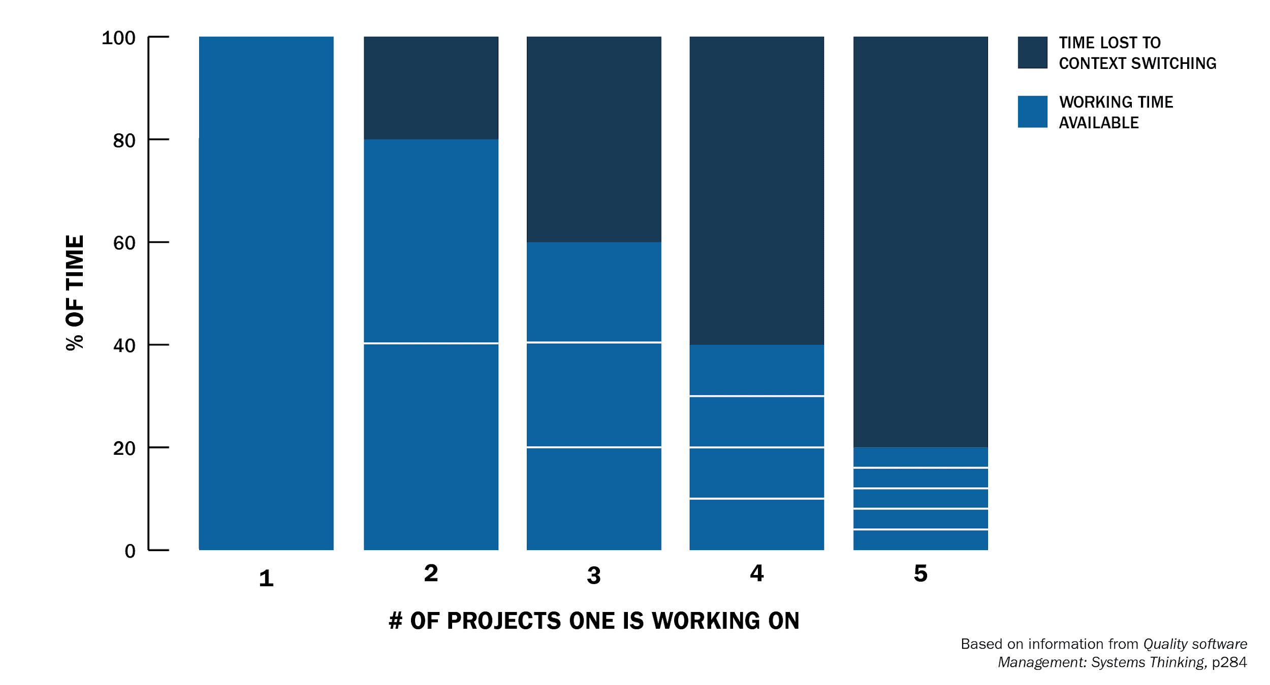
Complication: Context Switching is Expensive
According to the Software Engineering Institute at Carnegie Mellon University, context switching is extremely expensive.
Switching projects results in rapidly diminishing results
By implication, engineers manually tracking dependencies and switching to each manual task required for a specific service is similar in its impact on productivity
Given that dependencies assignments are clustered with dev leads handling 3-7 each, productivity can be heavily impacted
At 2 different tasks or projects, an engineer is losing 20% of their time to overhead. At 3 overhead jumps to 40%.
Any value over 3 results in losing the majority of a resource’s time to overhead and context switching
Frequently, staff is assigned to multiple projects and jumps between meeting, reporting and development activities
Notes:
https://insights.sei.cmu.edu/devops/2015/03/addressing-the-detrimental-effects-of-context-switching-with-devops.html
Joel Spolsky on the particular challenges of task-switching for programmers:
The trick here is that when you manage programmers, specifically, task switches take a really, really, really long time. That's because programming is the kind of task where you have to keep a lot of things in your head at once. The more things you remember at once, the more productive you are at programming. A programmer coding at full throttle is keeping zillions of things in their [sic] head at once: everything from names of variables, data structures, important APIs, the names of utility functions that they wrote and call a lot, even the name of the subdirectory where they store their source code. If you send that programmer to Crete for a three week vacation, they will forget it all. The human brain seems to move it out of short-term RAM and swaps it out onto a backup tape where it takes forever to retrieve.
Joel calls this the “task switching penalty.”

Slide 11
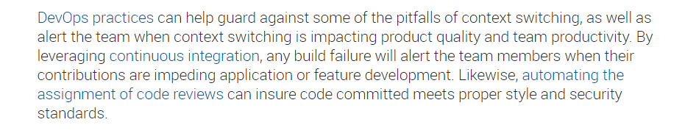
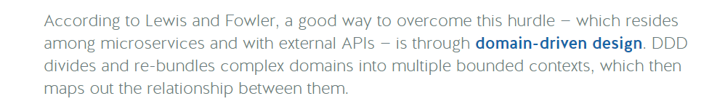
Complication: Context Switching is Expensive
Notes:
https://nordicapis.com/microservices-architecture-the-good-the-bad-and-what-you-could-be-doing-better/
https://blog.trello.com/why-context-switching-ruins-productivity
https://insights.sei.cmu.edu/devops/2015/03/addressing-the-detrimental-effects-of-context-switching-with-devops.html
https://particular.net/blog/microservices-future-or-empty-hype

Slide 12
Situation: Executive leadership wants a roadmap, time to plan!
Fly everyone to one location
Lock the team in a meeting room for 4-5 days
Size and plan user stories for the next 10, 15, or 20 weeks using scaled agile or another agile methodology
Deliver roadmap to leadership!

Slide 13
Complication: Dependencies
Typical app in a good case will have approx. 15 dependencies on other development groups
Manual handoffs of data in file share drives
Sharing of data tables
Requisition of data center resources
Approval from internal security groups
Future creation of API’s
Often private and undocumented

Slide 14
Complication
With no mechanism to reduce complexity, the application grows more complex
Add dependencies
Add features
Add Security
Etc.

Slide 15
Complication: Deploying the complex app is hard
Updates are less frequent
Velocity slows
Long QA cycles
Multiple development teams must coordinate deployment and releases
FEAR of new features

Slide 16
Complication: Scaling the complex app is hard
We must scale the monolith, but it is highly coupled
The best option is often to place it in a larger server (more CPU, memory)
Typically very expensive to scale vertically
Application becomes more vulnerable to outage and downtime

Slide 17
Complication: Updating the complex app is hard
Long term commitment to technology choices
Slow application startup times can drag down developer velocity as well
Cost increases
Perhaps fall behind newer competitors implementing on new technologies
In 1965, the average tenure of companies on the S&P 500 was 33 years. By 1990, it was 20 years. It's forecast to shrink to 14 years by 2026.
About 50 percent of the S&P 500 will be replaced over the next 10 years

Slide 18
Resolution: Microservice Architecture
Resolution: Create a Loosely Coupled API Service Platform, aka “Microservices”
Decentralize planning and eliminate interdependencies
This will make it possible for a team of developers to conduct their planning and development in isolation, vastly improving time to market and cutting cost.
A team of 7 planning without dependencies, with all the personnel required can reasonably plan for 10 weeks in a 1-2 days which would result in agile planning event savings alone of 50%
Skeptical? Consider a new team developing on Public Cloud (a Loosely Coupled API Service Platform)
(+) For example, a new development team on Cloud can submit API calls to create a VM, configure security routes, setup a firewall and create a database within minutes.
(-) The same operations within a common large enterprise often requires a complicated set of tickets and sophisticated connections to manage the hand-offs taking weeks to get started

Slide 19
Resolution: Microservices
Microservices enable Platforms
A platform is an ecosystem of APIs that third parties may build functionality on top of.
Notable Microservice Platform examples: Hootsuite, Gilt Group, SoundCloud, Amazon Web Services, Netflix, Spotify, Google Cloud, Box, and more!

Slide 20
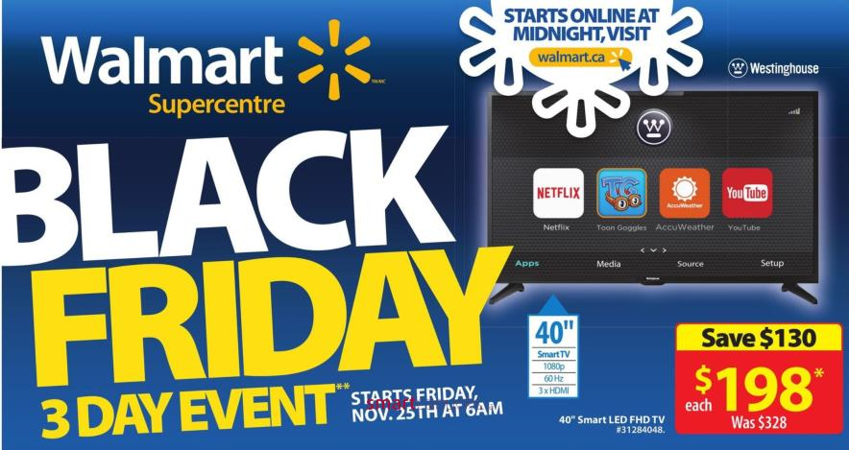
Walmart Canada Case Study
Notes:
The next few slides relate how Walmart Canada transitioned to microservice patterns using the following rubric for priorities:
They needed a new platform which was:
Message-driven (distribution, location transparency, isolation)
Resilient (supervision, dedicated separate error channel)
Elastic (scale up, async, non-blocking, scale out, immutable data, share nothing)
Responsive (responsive to events, load, failure, users, embrace new concepts and patterns, cluster computing, distribution of data, new patterns like circuit breakers)

Slide 21
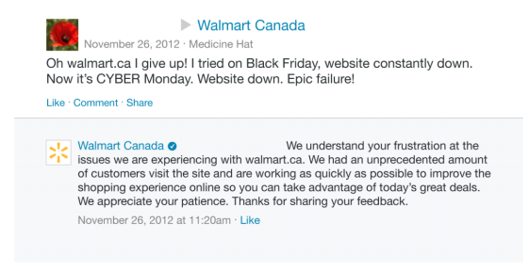
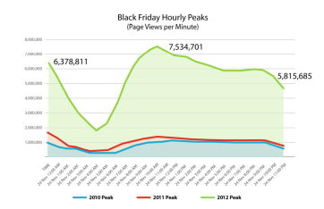
Walmart Canada: Situation
Designed in 2012, Walmart Canada’s website failed on Black Friday for two years in a row.
Traffic was increasing every year, keeping the team off balance
Customer backlash, competitive pressures (i.e. Amazon) made this a top priority

Slide 22
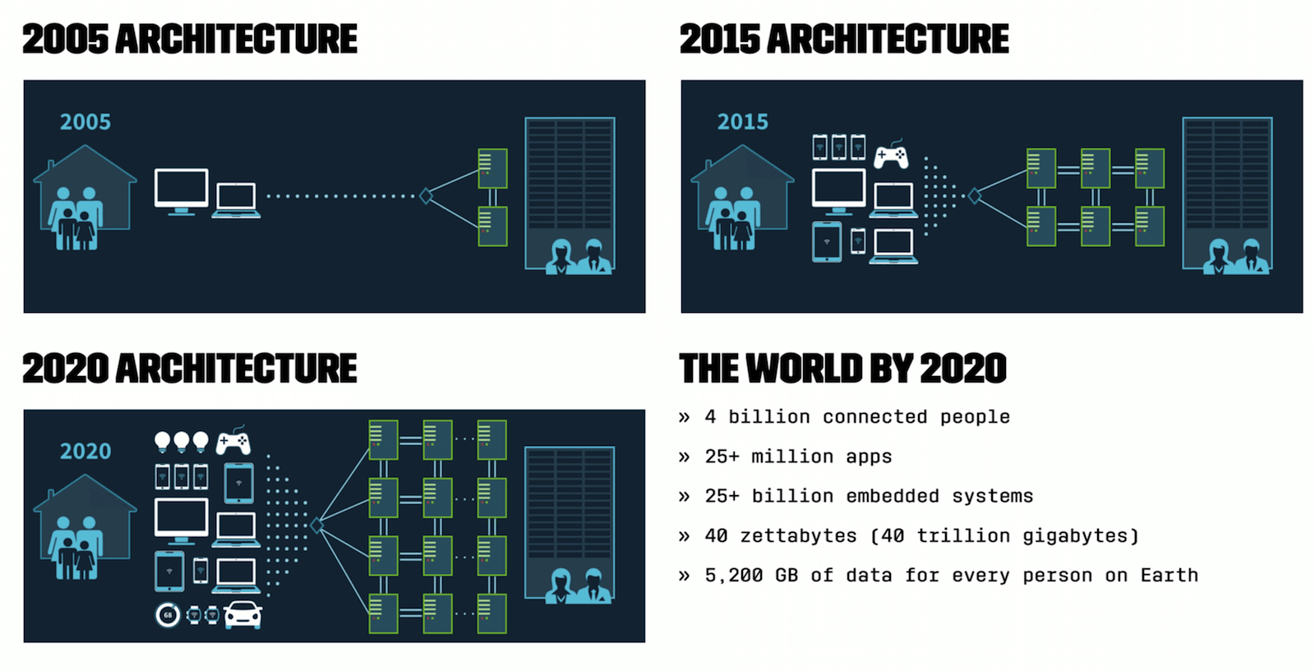
Walmart Canada: Action
With traffic likely to continue to increase, goals were set
Near 100% availability
Consistent responsiveness under varying load conditions
Predictable spikes of traffic e.g. Black Friday
Less predictable spikes e.g. marketing campaign

Slide 23
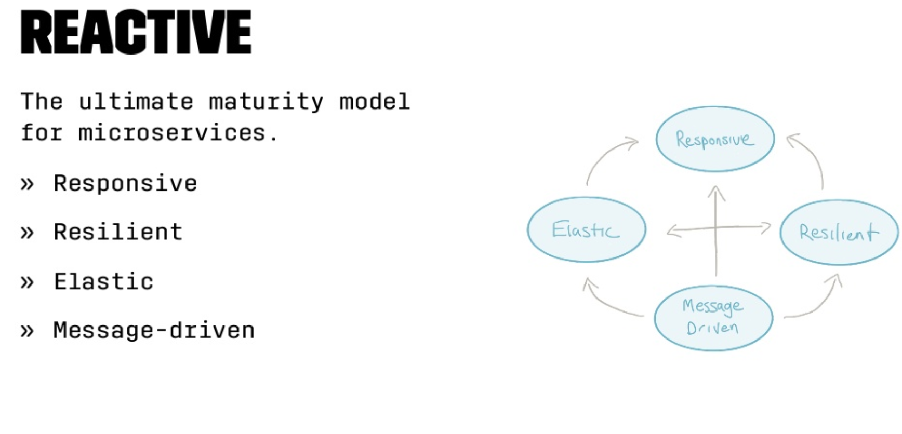
Walmart Canada: Action
Re-architected solution

Slide 24
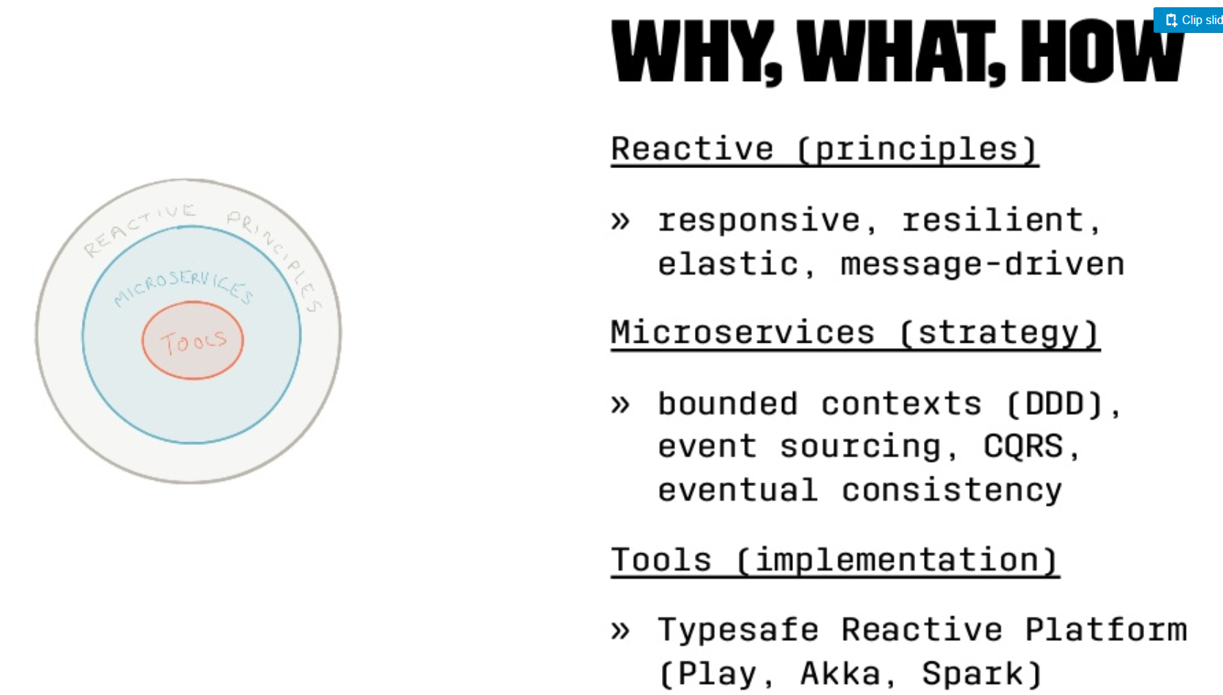
Walmart Canada: Action

Slide 25
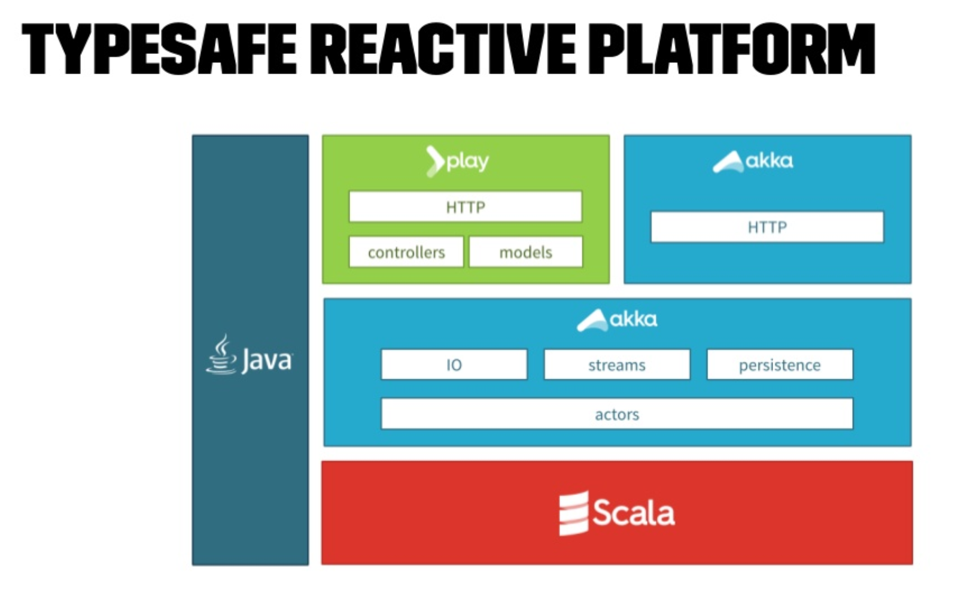
Walmart Canada: Action

Slide 26
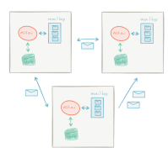
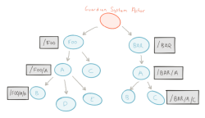
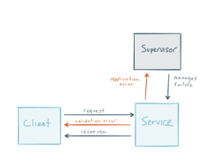
Walmart Canada: Action
Re-architected solution
Message Driven
Distribution
Location transparency
Isolation
Resilient
Supervision
Dedicated separate error channel

Slide 27
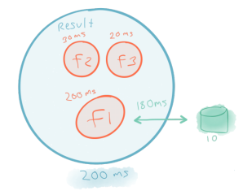
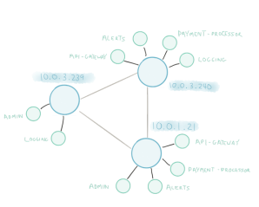
Walmart Canada: Action
Elastic
Scale up
Async
Non-blocking
Scale out
Immutable data
Share nothing
Responsive
Responsive to events, load failure, users
Distribution of data
Circuit Breakers

Slide 28
Walmart Canada: Result
Business Uplift
Conversions up 20%
Mobile orders up 98%
No downtime on Black Friday or Boxing Day
Operational Savings
Moved off expensive hardware
Cheap virtual x86 servers
20-50% cost savings
~40% compute cycles
Notes:
References:
https://www.slideshare.net/kvnwbbr/revitalizing-walmarts-aging-architecture-for-web-scale
https://www.youtube.com/watch?v=SPGCdziXlHU

Slide 29
How to break an application into Microservices?
Based on existing system and natural architectural boundaries
Database can be exposed as a Microservice for example
Any slow process behind a queue can be considered a Microservice
Language boundaries are an opportunity for Microservice creation

Slide 30

Strategy for legacy monoliths: The Strangler Pattern
https://flic.kr/p/nMWBkR
Notes:
The ’Strangler’ Pattern, as described by Martin Fowler. The pattern involves gradual replacement of a system by implementing new features in a new application that is loosely coupled to an existing system. Porting existing functionality from the original application only where necessary.

Slide 31
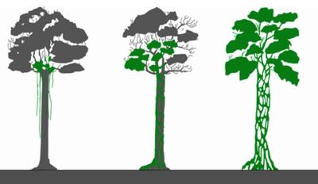
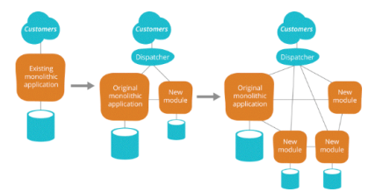
Strategy for legacy monoliths: The Strangler Pattern
Gradually replace a legacy system by implementing new features of an existing system with those in one or several new systems
Rather than trying to replace a large, expensive legacy system all at once you can iterate and improve in small amounts.
This can be implemented for example by a load balancer in front the targeted functionality
Over time, the old application is ‘strangled’ like a tree that has hosted a Strangler Fig.
Focus on quick wins, needs that were not satisfied by existing software to deliver the most value quickly.
Notes:
Talking points for stakeholders – key benefits:
One big benefit of this pattern is that is much more likely to get approved. Enterprises will debate replacing a large legacy system for years, but a team can deliver a quick prototype that replaces a single feature in a sprint. This effort can be built upon and a difficult legacy software component can be replaced in a more iterative and natural manner.
Another benefit is the deployability of new components. Ideally building them on a PaaS or other rapid development infrastructure.
SSD interfaces that external people use. For use to make changes we have to make sure we do not break the drives.
External customer wants a feature? Lightweight showcasing on the microservice platform is a great way to greenlight.

Slide 32
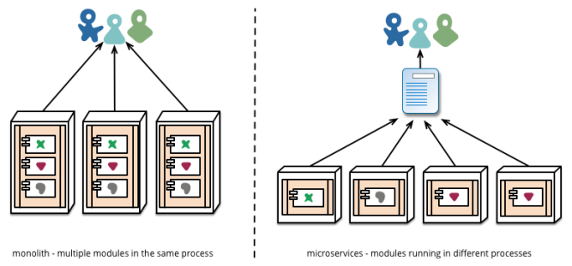
What is a Microservice?
A service that can be independently deployed
Notes:
Reference: https://martinfowler.com/articles/microservices.html

Slide 33
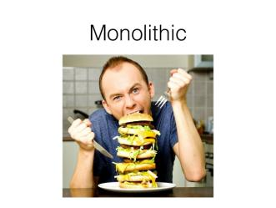
How big is a Microservice?
A single programmer can design, implement, deploy and maintain a Microservice – Fred George
Software that fits in your head – Dan North

Slide 34
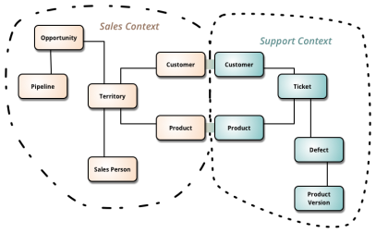
Where is the data for a Microservice?
A single logical database per service – Chris Richardson
A Microservice implements a single Bounded Context; Data model is driven by the domain model (DDD)
Event driven data Management
Notes:
Reference: https://martinfowler.com/bliki/BoundedContext.html
https://www.nginx.com/blog/event-driven-data-management-microservices/

Slide 35
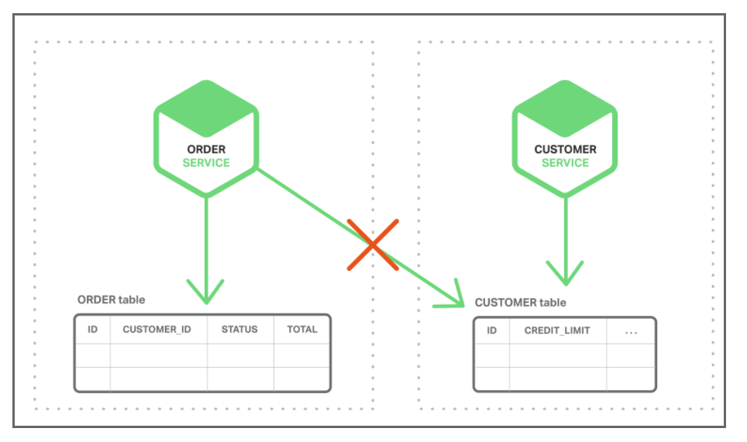
Event Driven Data Management
Implement business transactions that maintain consistency across multiple services
Implement queries that retrieve data from multiple services
Notes:
https://www.nginx.com/blog/event-driven-data-management-microservices/

Slide 36
Event Driven Data Management
Microservice publishes an event when something notable happens, such as when it updates a business entity. Other microservices subscribe to those events. When a microservice receives an event it can update its own business entities, which might lead to more events being published.
use events to implement business transactions that span multiple services
Notes:
https://www.nginx.com/blog/event-driven-data-management-microservices/

Slide 37
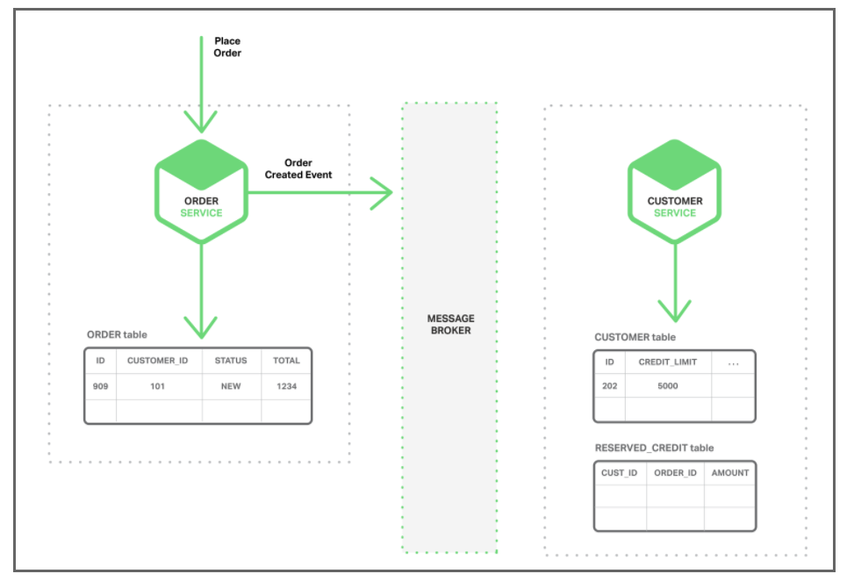
Event Driven Data Management
1. The Order Service creates an Order with status NEW and publishes an Order Created event.
Notes:
https://www.nginx.com/blog/event-driven-data-management-microservices/

Slide 38
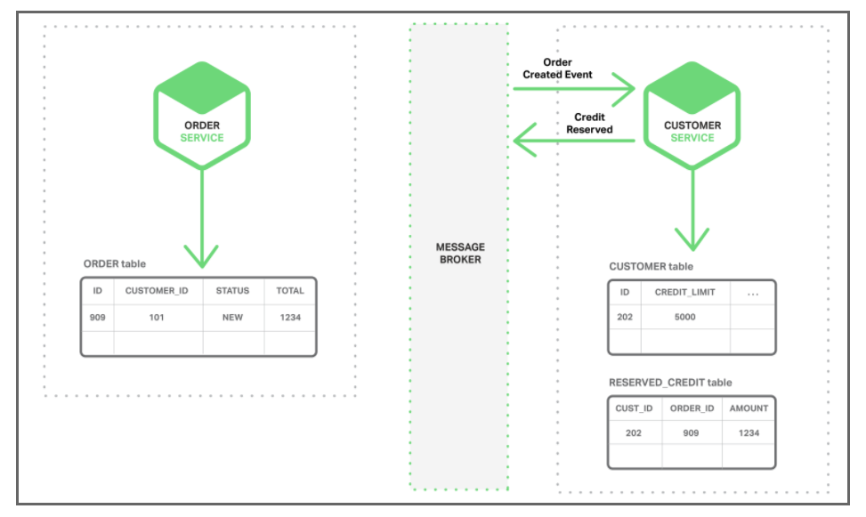
Event Driven Data Management
2. The Customer Service consumes the Order Created event, reserves credit for the order,
and publishes a Credit Reserved event.
Notes:
https://www.nginx.com/blog/event-driven-data-management-microservices/

Slide 39
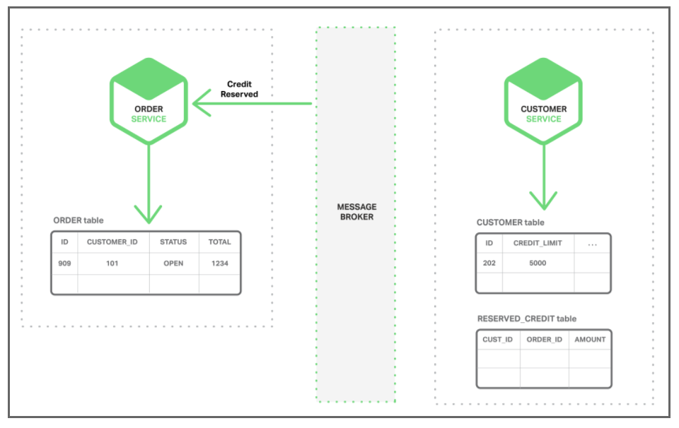
Event Driven Data Management
3. The Order Service consumes the Credit Reserved event, and changes
the status of the order to OPEN.
Notes:
https://www.nginx.com/blog/event-driven-data-management-microservices/

Slide 40
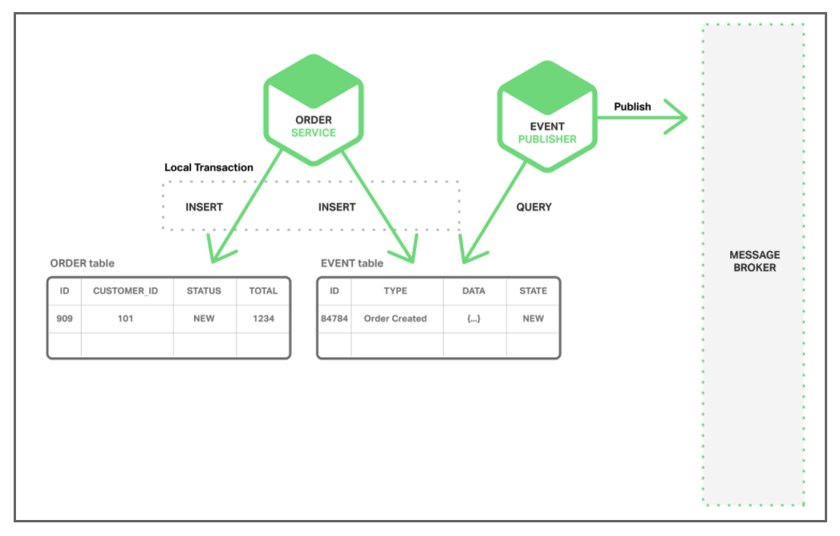
Event Driven Data Management - Preserve Atomicity
EVENT table -- functions as a message queue, in the database that stores the state of the business entities. The application begins a (local) database transaction, updates the state of the business entities, inserts an event into the EVENT table, and commits the transaction. A separate application thread or process queries the EVENT table, publishes the events to the Message Broker, and then uses a local transaction to mark the events as published.
Notes:
https://www.nginx.com/blog/event-driven-data-management-microservices/

Slide 41
How to maintain Microservices?
Addressable through a service discovery system – Chris Richardson
Microservices built & deployed independently. Stateless, with state as backing services – 12Factor.net
** Service Discovery – Will discuss in “Patterns”
Notes:
https://www.nginx.com/blog/service-discovery-in-a-microservices-architecture/

Slide 42
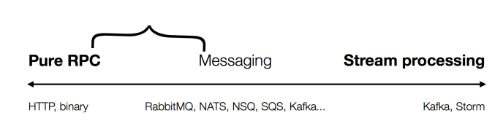
How to architect Microservices?
Typically
CRUD – Create, Read, Update and Delete API implementations
Range between RPC, Message and Stream processing
Evolve from a Monolith 1st iteration

Slide 43
Microservice: advantages
Simple services that are focused on doing one thing well
Each service can be built using the best tool for the job
Systems built this way are inherently loosely coupled
Teams can deliver and deploy independently from each other
Enable continuous delivery but allowing frequent releases while the rest of the system continues to be stable
Notes:
Can be (but not always)
< 6000 lines
Reference: https://martinfowler.com/articles/microservices.html

Slide 44
Microservices
Solve organizational problems
Teams blocked by or waiting on other teams
Communication overhead
Slow velocity
Cause Technical Problems
Requires Devops, devs deploying and operating their services
Need well defined business domains
More distributed systems
Need an orchestration layer

Slide 45
Self Service Mandate (Build a Platform)
All teams will expose their data and functionality through self service Api interfaces
No other forms of communication allowed, no tickets, direct linking, reads of data stores, no back doors, only service interface calls over the network
All services must be designed to be externalizable. The team must plan and design to be able to expose the api’s to developers in the outside world, creating a platform.
The now-famous Jeff Bezos rant, leading to formation of Amazon Web Services https://gist.github.com/chitchcock/1281611

Slide 46
Devops = Optimize for Speed
“Therefore, broadly speaking, to achieve DevOps outcomes we need to reduce the effects of functional orientation (“optimizing for cost”) and enable market orientation (“optimizing for speed”).”
-Gene Kim
This consists of having many small teams work independently, rapidly delivering customer value
Teams are cross-functional and independent. Each team, consisting of 8 or fewer resources, deploys independently.
Market oriented teams are responsible for feature development, testing, securing, deploying, and supporting service in production
Notes:
Reference: http://itrevolution.com/conways-law/

Slide 47
Microservices = Optimize for Speed
“Organizations with these types of service-oriented architectures, such as Google and Amazon, have incredible flexibility and scalability. These organizations have tens of thousands of developers where small teams can still be incredibly productive.”
-Randy Shoup, former Engineering Director for Google App Engine
This consists of having many small teams work independently, rapidly delivering customer value
Notes:
Reference: http://itrevolution.com/conways-law/
“Today, when organizations measure and optimize their activities, time to value is becoming a dominant metric.” – Adrian Cockcroft

Slide 48
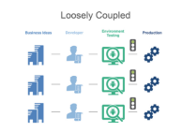
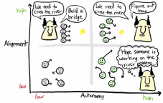
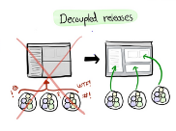
Small Team Size
Build platform with small teams of 6-8 engineer teams
Self Sufficient: Each team completely owns one or more services and has everybody they need to develop functionality
Automate Interfaces: Teams connect to each other through API’s. Teams don’t hire an army of program managers to manage dependencies.
Decentralized: Teams plan, develop and deploy autonomously
Starting and Scaling DevOps in the Enterprise by Gary Gruver https://www.amazon.com/dp/B01M332BN2/ref=dp-kindle-redirect?_encoding=UTF8&btkr=1
Notes:
Reference: https://clusterhq.com/2016/03/22/microservices-spotify-petter-mahlen
“There’s a yearly survey about what sucks about Spotify’s infrastructure. In 2015 service DB, the predecessor showed up as, I think, number 3 in what sucks. Whereas now, in 2016, System-Z is one of the things that gets the most frequent, “It’s great!” Even though we’re asking what sucks. “
“Another interesting thing we noticed is that it leads to teams building related features, infrastructure teams building related features, like an example is the team that owns hardware and provisioning, the team that owns DNS infrastructure, and the team that owns System-Z together have built like an improved version of how you do provisioning and deployment. “

Slide 49


Why Small Team Size? Scaling the Organization
Autonomy
Decentralizes power and creates autonomy which is critical to scaling the organization
Each team can focus on the business metric they are responsible for and act autonomously to maximize the metric.
Amazon CTO Werner Vogels explained the advantages of this structure to Larry Dignan of Baseline in 2005 (see notes accompanying this slide)
Science behind why two-pizza team works http://blog.idonethis.com/two-pizza-team/ ITRevolution, Conways Law by Gene Kim http://itrevolution.com/conways-law/
Notes:
Amazon CTO Werner Vogels explained the advantages of this structure to Larry Dignan of Baseline in 2005.
Dignan writes:
“Small teams are fast…and don’t get bogged down in so-called administrivia….Each group assigned to a particular business is completely responsible for it….The team scopes the fix, designs it, builds it, implements it and monitors its ongoing use. This way, technology programmers and architects get direct feedback from the business people who use their code or applications—in regular meetings and informal conversations.”
References:
http://blog.idonethis.com/two-pizza-team/
http://itrevolution.com/conways-law/

Slide 50
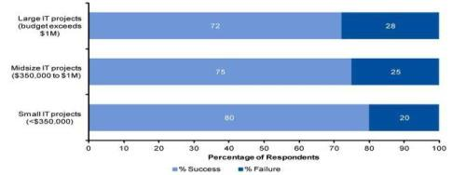
Why do Microservices?
Reduce complexity, increase success
According to a Gartner survey of 150 participants in 2011, the failure of projects exceeding $1 million was found to be almost 50% higher than for projects with budgets below $350,000.
This result was reinforced by prior Gartner IT projects which found small IT projects to experience a one-third lower failure rate than large projects
https://thisiswhatgoodlookslike.com/2012/06/10/gartner-survey-shows-why-projects-fail/

Slide 51
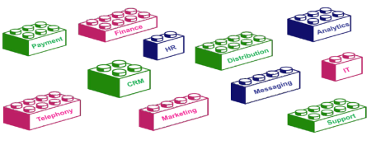
Microservice building blocks
APIs provide the flexibility for businesses to grow by adopting new business models and enable accelerated development of new applications.
It is like picking different LEGO blocks to build a toy house.
Notes:
As we make engineering decisions, we need to constantly consider impacts regarding:
Team Skills
Process & Measurements
Architecture & Engineering

Slide 52
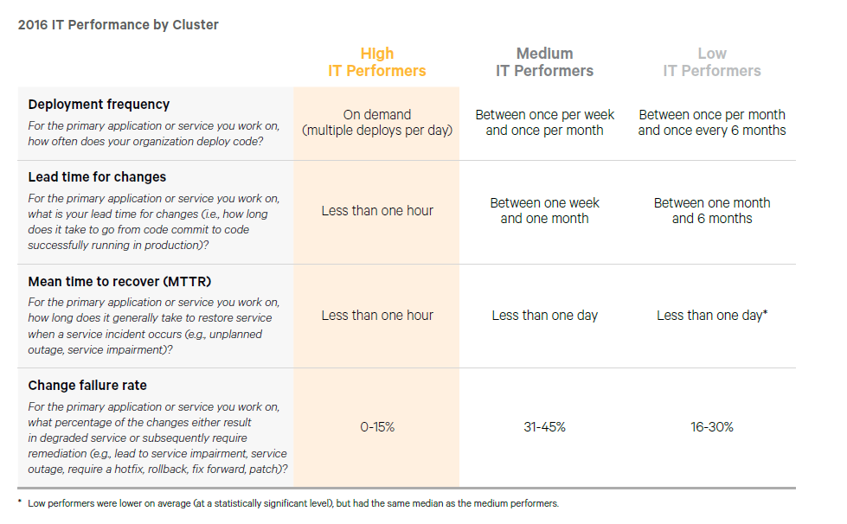
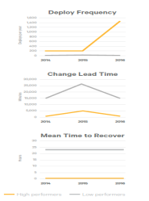
External Benchmarks
Competitive Advantage
High performing teams are breaking away from the pack and the status quo of even three years ago is a dangerous assumption currently.
A team which had state of the art development practices as recently as 3 years ago can find themselves outpaced by competition today.
* Source: Puppet Labs Report
Notes:
The third annual DevOps survey by Puppet Labs, IT Revolution Press and ThoughtWorks garnered more than 9,200 responses from technical professionals around the world
Companies with high-performing IT organizations are twice as likely to exceed their profitability, market share and productivity goals.
The individual measures that make up IT performance are deployment frequency, lead time for changes, and mean time to recover from failure
https://puppet.com/resources/white-paper/2014-state-of-devops-report/thank-you

Slide 53
Microservices Patterns
Before diving into Microservices Patterns, let’s walk through a Sample Monolithic Application.
Later we will convert the same application to Microservices and deploy in Kubernetes

Slide 54
Sample Monolithic App in Java
Get stock details
Get product details
Stock
Product
id
sku
availability
Product id
Product name
Product price
Output combined product detail using both redis databases

Slide 55
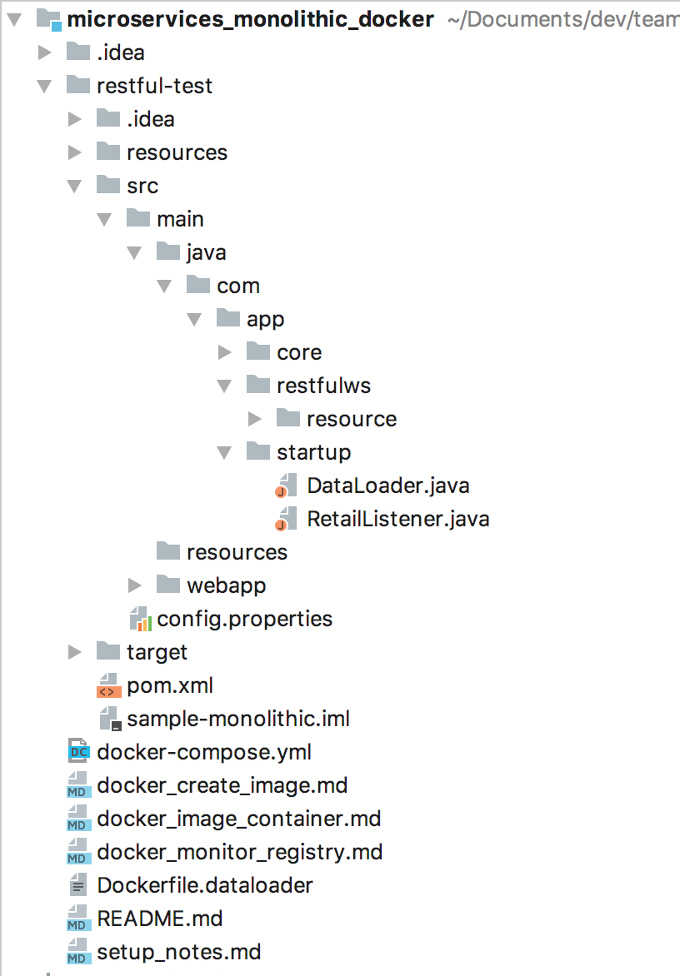
Project Structure
Static data to
load to redis
controller,
POJO
Jersey Rest
web.xml
Docker files
https://github.com/shekhar2010us/microservices_monolithic_docker/blob/master/README.md

Slide 56
Setup – Running Java Monolithic
Login to virtual machine
Install docker, maven and git
Pull code
Build code
Build docker image
Run docker-compose
https://github.com/shekhar2010us/microservices_monolithic_docker/blob/master/setup_notes.md

Slide 57

Writing Monolithic - Java
CLASSROOM WORK 101 (45 minutes)
Maven Build and Run application
Redis data store
Jersey Rest API
Docker compose
https://github.com/shekhar2010us/microservices_monolithic_docker
Notes:
https://github.com/shekhar2010us/restful-test

Slide 58
Patterns

Slide 59

What is a pattern?
Reusable solution to a problem occurring in a particular context
Notes:
slideshare.net/chris.e.richardson/microservices-pattern-language-microxchg-microxchg2016

Slide 60
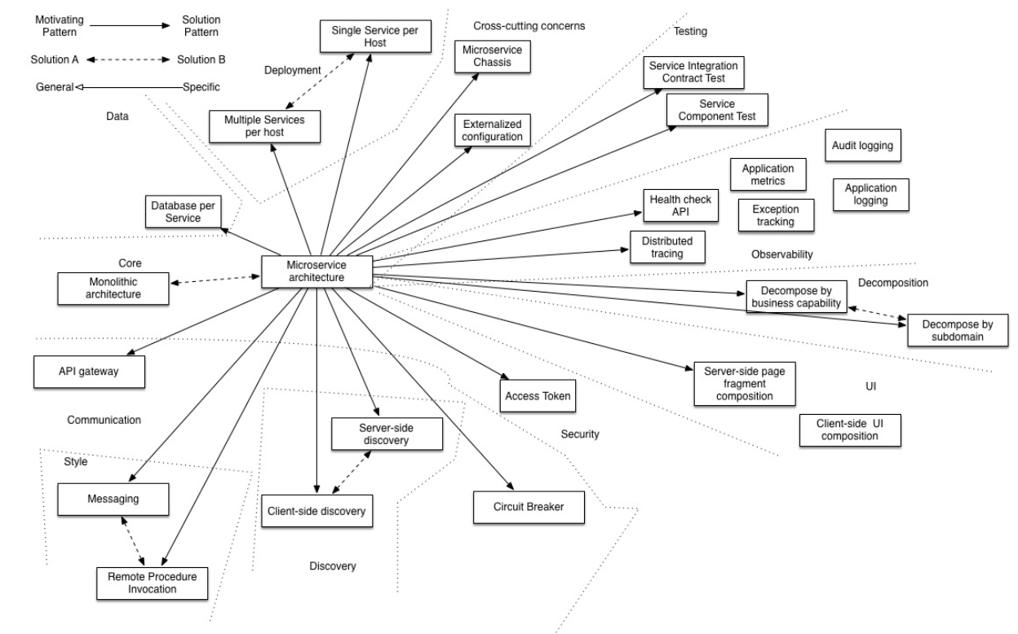
Microservice Architectures
Notes:
Reference: http://microservices.io/patterns/index.html

Slide 61
Pattern - Categories
Data Management
Communication
Deployment
Discovery
Reliability
Observability
Testing
Notes:
Private tables per service may be a middle ground between the two approaches, but care must be taken to enforce access controls.
Further Reading:
http://microservices.io/patterns/data/database-per-service.html
http://microservices.io/patterns/data/shared-database.html

Slide 62
Data Management Patterns
Shared database
Database per Service
Saga
Event Sourcing
CQRS (Command Query Responsibility Segregation)
API Composition
Notes:
Private tables per service may be a middle ground between the two approaches, but care must be taken to enforce access controls.
Further Reading:
http://microservices.io/patterns/data/database-per-service.html
http://microservices.io/patterns/data/shared-database.html

Slide 63
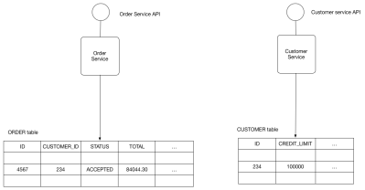
Shared Database
Shared Database
Use a (single) database shared by multiple services. Local ACID transactions.
Benefits:
Straightforward ACID transactions to enforce data consistency
Single database is simpler to operate
Drawbacks:
Since all services access the same database, interference and transaction locks on the table.
Single database might not satisfy the data storage and requirements of all services.
Notes:
Private tables per service may be a middle ground between the two approaches, but care must be taken to enforce access controls.
Further Reading:
http://microservices.io/patterns/data/database-per-service.html
http://microservices.io/patterns/data/shared-database.html

Slide 64
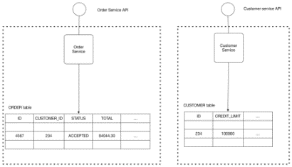
Database Per Service
Database Per Service
Every Microservice has its own persistent data and accessible only via its API
E.g. Private-tables-per-service; Schema-per-service; Database-server-per-service
Benefits:
Ensures loose coupling
Each service can use the type of database that is best suited to its needs. E.g., text searches could use ElasticSearch; social graph could use Neo4j.
Drawbacks:
Transactions involving multiple services not straight forward
For consistency; may need to implement capability to roll back (Saga pattern)
Interaction is achieved by message/event brokers
Notes:
Private tables per service may be a middle ground between the two approaches, but care must be taken to enforce access controls.
Further Reading:
http://microservices.io/patterns/data/database-per-service.html
http://microservices.io/patterns/data/shared-database.html

Slide 65
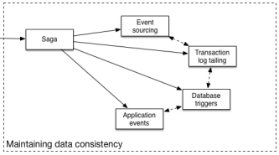
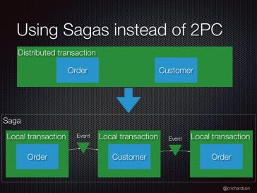
Saga Pattern – For Data Consistency
Saga Pattern
Grouping transactions with the capability to undo changes if the transaction fails
enables an application to maintain data consistency across multiple services
How to reliably/atomically publish
events whenever state changes?
Solution can be Event Sourcing
Notes:
Further Reading:
http://microservices.io/patterns/data/saga.html
http://microservices.io/patterns/data/api-composition.html

Slide 66
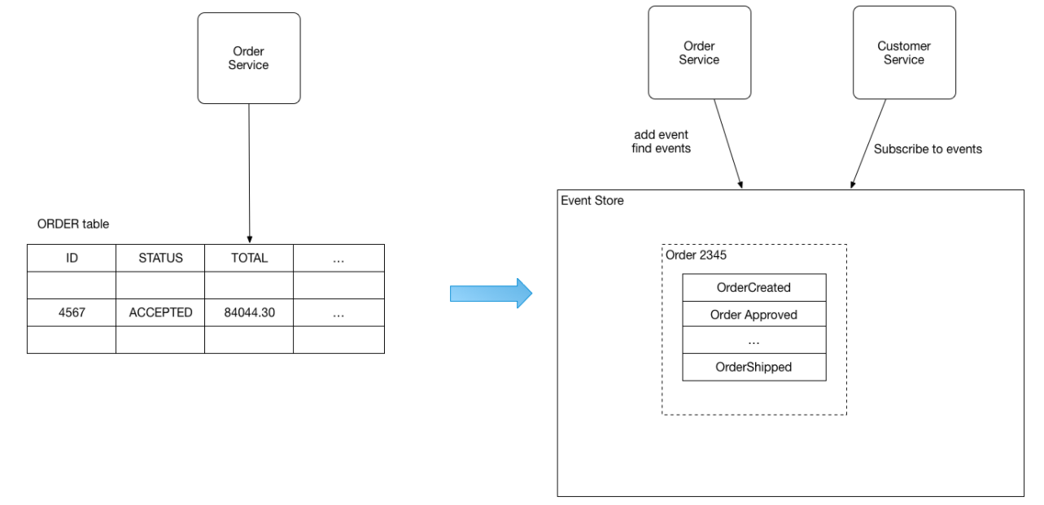
Event Sourcing
Persists the state of a business entity as a sequence of state-changing events – in Event Store
The store has APIs for adding, retrieving an entity’s events and subscribe to events.
The store is like a message broker; A new event is delivered to all interested subscribers.
E.g. the Order is saved as sequence of events, and customerService subscribe to those events
Benefits:
reliably publish events whenever state changes
Drawbacks:
Difficult to design (unconventional)
The event store is difficult to query since it requires typical queries to reconstruct the state of the business entities - complex and inefficient --- use CQRS to query
Notes:
Further Reading:
http://microservices.io/patterns/data/saga.html
http://microservices.io/patterns/data/api-composition.html

Slide 67
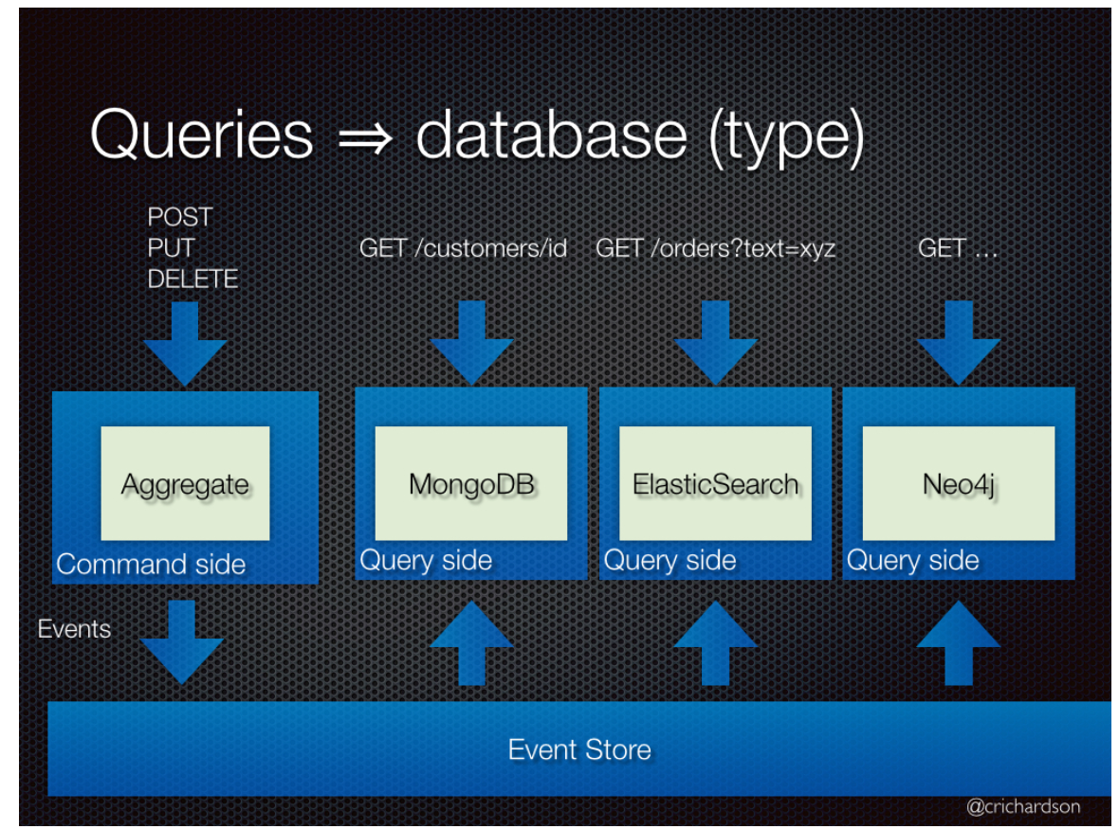
CQRS – Command Query Responsibility Segregation
Split the application into two parts:
Command-side: handles create, update, and delete requests and emits events when data changes.
Query-side: handles queries by executing them against one or more materialized views that are kept up to date by subscribing to the stream of events emitted when data changes.
A Command cannot return data and
a Query cannot change the data.
Use Case
Get data from multiple different Aggregates
Application has an imbalance in responsibility (read/writes)
How to
Two models talking to same datastore (applications that require synchronous processing and immediate results.)
Two models talking to different datastore (Eventual Consistency)
Notes:
Further Reading:
http://microservices.io/patterns/data/saga.html
http://microservices.io/patterns/data/api-composition.html

Slide 68
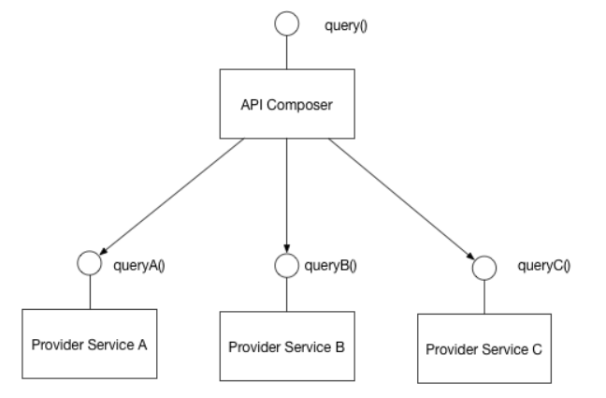
API Composition
Perform queries in Microservices architecture
Implement a query by defining an API Composer, which invoking the services that own the data and performs an in-memory join of the results.
Benefits:
It a simple way to query data in a Microservice architecture
Drawbacks:
Some queries would result in inefficient, in-memory joins of large datasets.
Notes:
Further Reading:
http://microservices.io/patterns/data/saga.html
http://microservices.io/patterns/data/api-composition.html

Slide 69
Pattern - Categories
Data Management
Communication
Deployment
Discovery
Reliability
Observability
Testing

Slide 70
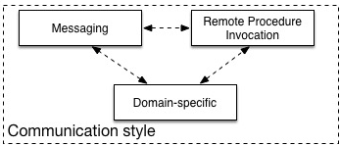
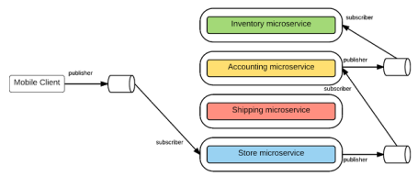
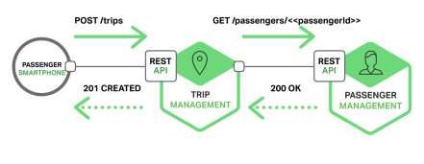
Communication Style
Messaging
Services communicate by sending asynchronous messages
Decouples client & service
Must also install and maintain a broker (Kafka, RabbitMQ, etc)
Complex and should be highly available
Remote Procedure Invocation
Simple and familiar
Both client and service must be available
Only simple request and reply. Notifications, publish/subscribe, async communication not supported
E.g. Rest, Thrift
Notes:
Domain specific protocol
Email such as SMTP or IMAP
Media streaming such as RTMP, HLS, etc
Further Reading:
http://microservices.io/patterns/communication-style/rpi.html
http://microservices.io/patterns/communication-style/messaging.html
http://microservices.io/patterns/communication-style/domain-specific.html

Slide 71
Pattern - Categories
Data Management
Communication
Deployment
Discovery
Reliability
Observability
Testing

Slide 72
Deployment Patterns
Service instance per host
Multiple Service instance per host
Service instance per VM
Service instance per container
Server-less

Slide 73
Service instance per host
Deploy each single service instance on its own host
Benefits:
Services instances are isolated from one another
There is no possibility of conflicting resource requirements or dependency versions
A service instance can only consume at most the resources of a single host
It is straightforward to monitor, manage, and re-deploy each service instance
Drawbacks:
Potentially less efficient resource utilization
Notes:
Further Reading:
http://microservices.io/patterns/deployment/service-per-container.html
http://microservices.io/patterns/deployment/serverless-deployment.html
http://microservices.io/patterns/deployment/service-per-vm.html

Slide 74
Multiple Service instance per host
Run multiple instances of different services on a host (Physical or Virtual machine).
Deploy each service instance as a JVM process. For example, a Tomcat or Jetty instances per service instance.
Deploy multiple service instances in the same JVM. For example, as web applications or OSGI bundles.
Benefits:
More efficient resource utilization
Drawbacks:
Risk of conflicting resource requirements
Risk of conflicting dependency versions
If multiple services instances are deployed in the same process then its difficult to monitor the resource consumption of each service instance. It’s also impossible to isolate each instance
Notes:
Further Reading:
http://microservices.io/patterns/deployment/service-per-container.html
http://microservices.io/patterns/deployment/serverless-deployment.html
http://microservices.io/patterns/deployment/service-per-vm.html

Slide 75
Service instance per VM
Package the service as a virtual machine image and deploy each service instance as a separate VM
Benefits:
Straightforward to scale the service by increasing the number of instances. Amazon Autoscaling Groups can even do this automatically based on load.
The VM encapsulates the details of the technology used to build the service. All services are, for example, started and stopped in exactly the same way.
Each service instance is isolated
A VM imposes limits on the CPU and memory consumed by a service instance
Drawbacks:
Building a VM image is slow and time consuming
Notes:
Further Reading:
http://microservices.io/patterns/deployment/service-per-container.html
http://microservices.io/patterns/deployment/serverless-deployment.html
http://microservices.io/patterns/deployment/service-per-vm.html

Slide 76
Service instance per Container
Package the service as a (Docker) container image and deploy each service instance as a container
E.g. Kubernetes, DC/OS, Marathon/Mesos, Docker Swarm
Benefits:
Easy to scale up and down a service by changing the number of container instances.
The container encapsulates the details of the technology used to build the service.
Each service instance is isolated
A container imposes limits on the CPU and memory consumed by a service instance
Containers are extremely fast to build and start. E.g. 100x faster to package an application as a Docker container than it is to package it as an AMI.
Drawbacks:
Less mature than VMs
Notes:
Further Reading:
http://microservices.io/patterns/deployment/service-per-container.html
http://microservices.io/patterns/deployment/serverless-deployment.html
http://microservices.io/patterns/deployment/service-per-vm.html

Slide 77
Server-less
Deployment infrastructure hides the concept of servers and takes the service’s code & desired performance characteristics and runs the service.
The deployment infrastructure is a utility operated by a public cloud provider. It typically uses either containers or virtual machines to isolate the services.
E.g. AWS Lambda, Google Cloud Functions, Azure functions
Benefits:
Eliminates the need to spend time on the heavy lifting of managing low-level infrastructure.
Extremely elastic. It automatically scales your services to handle the load.
You pay for each request rather than provisioning what might be under utilized VMs or containers.
Drawbacks:
Has far more constraints than a VM/Container-based infrastructure. E.g., language support.
Only suitable for deploying stateless applications, not for long running stateful or message broker.
Risk of high latency - the time it takes for the infrastructure to provision an instance and for the function to initialize might result in significant latency.
Can only react to increases in load, cannot proactively pre-provision capacity.
Notes:
Further Reading:
http://microservices.io/patterns/deployment/service-per-container.html
http://microservices.io/patterns/deployment/serverless-deployment.html
http://microservices.io/patterns/deployment/service-per-vm.html

Slide 78
Pattern - Categories
Data Management
Communication
Deployment
Discovery
Reliability
Observability
Testing

Slide 79
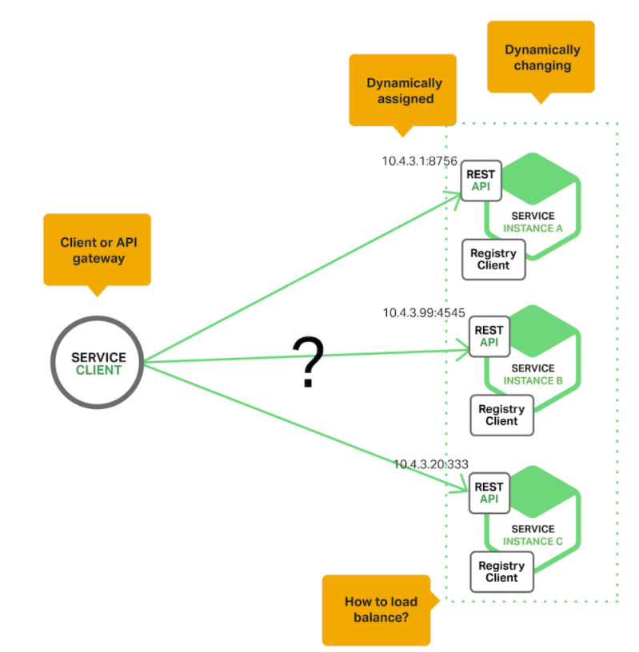
Service Discovery
Service instances have dynamically assigned network locations. Moreover, the set of service instances changes dynamically because of autoscaling, failures, and upgrades. Consequently, the client code needs to use a more elaborate service discovery mechanism.
Notes:
https://www.nginx.com/blog/service-discovery-in-a-microservices-architecture/
Discovery is one of the first issues encountered when implementing microservices. One of Kubernetes initial innovations was a DNS method for services to communicate with one another. Nearly every modern microservice platform has its own service discovery method that is a variant of one discussed here.
Fewer moving parts than Server side service discovery, but couples the client to the Service Registry.
Further Reading:
http://microservices.io/patterns/client-side-discovery.html

Slide 80
Service Registry
Key of service discovery
Database containing the network locations of service instances.
Needs to be highly available and up to date.
Clients can cache network locations obtained from the service registry -- that information eventually becomes out of date
A service registry consists of a cluster of servers that use a replication protocol to maintain consistency.
E.g. Netflix Eureka, consul, Zookeeper
https://github.com/hashicorp/consul-template -- dynamically reconfigure NGINX nginx.conf
Notes:
https://www.nginx.com/blog/service-discovery-in-a-microservices-architecture/

Slide 81
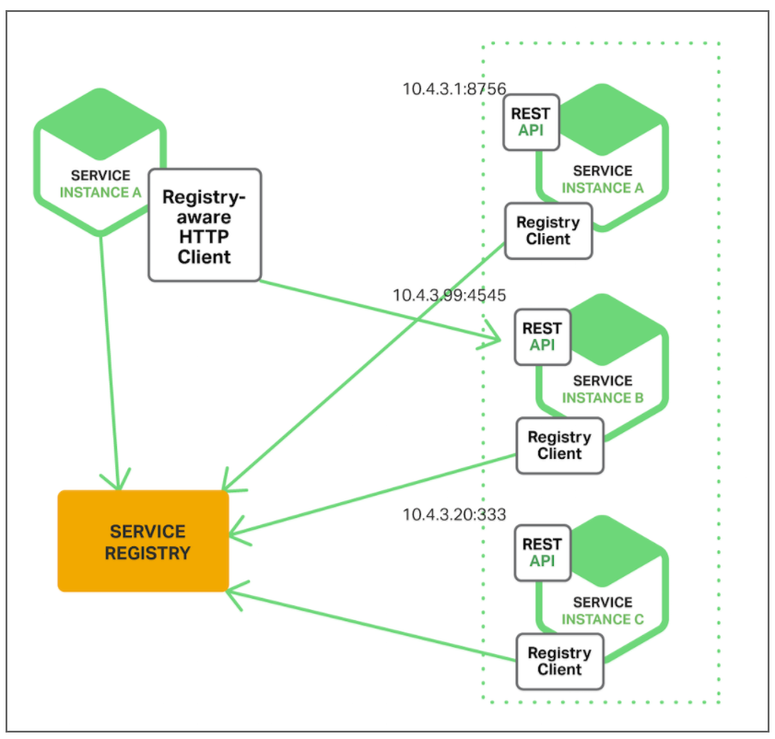
Client-side Service Discovery Pattern
The client queries a service registry, which is a database of available service instances. The client then uses a load‑balancing algorithm to select one of the available service instances and makes a request.
E.g. Netflix OSS
Notes:
https://www.nginx.com/blog/service-discovery-in-a-microservices-architecture/

Slide 82

Server-side Service Discovery Pattern
The client makes a request to a service via a load balancer. The load balancer queries the service registry and routes each request to an available service instance. As with client‑side discovery, service instances are registered and deregistered with the service registry.
E.g. Kubernetes, Mesos, AWS Elastic Load Balancer
Notes:
https://www.nginx.com/blog/service-discovery-in-a-microservices-architecture/

Slide 83


API Gateway
Single entry point for all clients. The API gateway handles requests in one of two ways:
Proxied/routed to the appropriate service
Fanned out to multiple service
The API gateway can expose a different API for each client.
E.g., Netflix API gateway runs client-specific adapter code
Benefits:
Insulates the clients from how the application is partitioned into microservices
Insulates the clients from the problem of determining the locations of service instances
Provides the optimal API for each client
Drawbacks:
Increased complexity - another moving part to develop, deployed and managed
Increased response time due to the additional network hop through the API gateway.
E.g. Netty
Notes:
Reference: http://microservices.io/patterns/apigateway.html

Slide 84
Pattern - Categories
Data Management
Communication
Deployment
Discovery
Reliability
Observability
Testing

Slide 85

Circuit Breaker
Reason:
Remote calls can fail, reach timeout due to unresponsive supplier.
Increased number of calls may lead to cascading failures across multiple systems
What is it:
Wrap a protected function call in a circuit breaker object, which monitors for failures. Once the failures reach a certain threshold, the circuit breaker trips, and all further calls to the circuit breaker return with an error, without the protected call being made at all.

Slide 86
Pattern - Categories
Data Management
Communication
Deployment
Discovery
Reliability
Observability
Testing

Slide 87
Observability Patterns
Application Metrics
Health check API
Distributed Tracing
Exception Tracking
Log aggregation
Audit Logging

Slide 88

Observability (Metrics)
Health Check API
A health check client - a monitoring service - periodically invokes the endpoint to check the health of the service instance
Ideally, you have a service that can ensure your service is active and accepting requests, a ’Health Check’
Health check examples included Consul, Kubernetes, and various libraries such as Sprint Boot, Gokit, etc.
Application Metrics
Need to understand the behavior of an application so performance and other problems can be proactively managed
Typically come in two models:
Push – service pushes metrics (typically an agent) from the service
Pull – Service pulls metrics from the service (typically a dashboard)
Examples include Prometheus, AWS Cloud Watch, Sysdig, etc
Notes:
http://microservices.io/patterns/observability/application-logging.html
http://microservices.io/patterns/observability/application-metrics.html

Slide 89
Observability Metrics
USE method (Brendan Gregg)
For every resource, check
Utilization: average time that the resource was busy servicing work
Example: One disk is running at 90%
Saturation: the degree to which the resource has extra work which it can’t service, often queued
Example: The CPUs have an average run queue length of four
Error count (rate): the count of error events
Example: This network interface has had fifty late collisions
Useful for resources such as queues, CPU’s, memory, interconnects, etc.
Notes:
http://www.brendangregg.com/usemethod.html

Slide 90

Notes:
http://www.brendangregg.com/linuxperf.html

Slide 91
Observability Metrics
RED method (Tom Wilkie)
For every service, check that
Request count (rate)
Error count (rate)
Duration
Note:
Observability = Logging + Monitoring + Tracing + Visualization
All good instrumentation libraries (Prometheus, Graphite, etc.) have at least three main primitives
Counter: records events that happen such as incoming requests, bad requests, errors, etc.
Gauge: records things that fluctuate over time such as the size of a thread pool
Histogram: records observations of scalar quantities of events such as request durations
Notes:
http://www.brendangregg.com/usemethod.html

Slide 92

Observability (Tracing)
Distributed Tracing
It becomes quite important to understand what broke and why
Common Distributed Tracing functionality
Assign each external request a unique ID
Pass ID to all services involved with handling the request
Include id in all log messages
Record information (start/end time) about requests and operations performed
Notes:
http://microservices.io/patterns/observability/distributed-tracing.html

Slide 93

Observability (Exceptions and Logging)
Exception Tracking
It is crucial to save errors and the corresponding stack trace
Ideally, exceptions are de-duplicated and recorded for further aggregation and investigation
Log deployments and changes
Track changes as they are opportunities for failure
For example, tracking deployments and changes so they can be easily correlated with issues later for faster resolution
*Etsy graphing error rates against new code deployments
Notes:
http://microservices.io/patterns/observability/exception-tracking.html
https://codeascraft.com/2010/12/08/track-every-release/

Slide 94
Observability (Aggregation and Audit)
Log Aggregation
Requests span multiple instances over multiple machines. It is important to gather information in a standardized format
Log files contain errors, warnings, and debug information
It is important to aggregate, search and analyze such logs
Popular solutions for this include the ELK stack (Elastic Search, Logstash and Kibana) and AWS Cloud Watch
Audit Logging
It is vital to know actions a user has performed.
For security and compliance, this is often a must have
Average time to detect intrusions is 98 days for financial services, 197 days for retail, it should/can be much lower
Notes:
Days to intrusion: http://www.zdnet.com/article/businesses-take-over-six-months-to-detect-data-breaches/
http://microservices.io/patterns/observability/audit-logging.html
http://microservices.io/patterns/observability/application-logging.html

Slide 95
Logging best practices
Log output as a set of JSON key/value pairs instead of pure text
Easier for computer to test and aggregate
Easier to make rules and query
Comprehensive
Do this:
“Timestamp: 2017-09-01 1:25”, ”caller”:”main.go:5”, “transport”:”HTTP”,”addr”:”8080”
Not this
“2017-09-01 1:25 main.go 5 HTTP 8080”

Slide 96
Pattern - Categories
Data Management
Communication
Deployment
Discovery
Observability
Testing

Slide 97

Service Integration/Component Testing
Service Integration Contract Tests
End-to-end testing is slow and expensive
Test the APIs (functionality) provided by services
Black box testing
Service Component Tests
Test the components of the service
A test suite that tests a service in isolation using test doubles for any services that it invokes.
White box testing

Slide 98
End-To-End tests Vs Unit Test
End-to-end tests: time taking and expensive
The dev team might have to spend weeks finding all the issues breaking the end-to-end test
They would be better served with a large base of unit test that find bugs quickly
Slow
No isolated failures
Simulates a real user
Unit Tests: Fast and cheap
Unit tests should form the majority of tests as they quickly identify bugs and represent a fast feedback loop
When a Unit test fails, the function and area that fails is much narrower in scope than broad end-to-end tests
Fast
Isolated Failures
But do not simulates a real user
Notes:
Reference: https://testing.googleblog.com/2015/04/just-say-no-to-more-end-to-end-tests.html
Analysis
Despite numerous problems, the tests ultimately did catch real bugs. What Went Well
Customer-impacting bugs were identified and fixed before they reached the customer.
What Went Wrong
The team completed their coding milestone a week late (and worked a lot of overtime).
Finding the root cause for a failing end-to-end test is painful and can take a long time.
Partner failures and lab failures ruined the test results on multiple days.
Many smaller bugs were hidden behind bigger bugs.
End-to-end tests were flaky at times.
Developers had to wait until the following day to know if a fix worked or not.

Slide 99
Testing Pyramid
Google recommends a 70/20/10 test composition split
70% unit tests
20% integration tests
10% end-to-end tests
End-to-End
Integration
Unit

Slide 100

Technical Debt Payback
Addressing Technical Debt makes an assumption that the team will get a payoff on their investment
Have more unit tests, helps in continuous deployment, helps in fast tracking of errors and building a resilient product – This reduces technical debt
The interest from technical debt can be used to reduce even more technical debt (compounding)
Notes:
https://martinfowler.com/bliki/DesignStaminaHypothesis.html
https://martinfowler.com/bliki/TechnicalDebt.html
https://www.safaribooksonline.com/library/view/Managing+Software+Debt:+Building+for+Inevitable+Change/9780321700582/footnote.html#ftn.ch02fn3

Slide 101


Static Code Metrics
Coding Techniques to Improve Architecture Agility
Code Complexity – recommended about 20 lines per method
Cyclomatic Complexity (# of linearly independent paths) – recommend keep it low
Coupling (measure of how many classes a single class uses), keep it low
Inheritance, no deeper than 6.
Cyclomatic Complexity
Class coupling example
Notes:
Cyclomatic Complexity
Describes the number of paths that go through your code and correlates to the number of unit tests you have to write
Soft recommendation of 1-5. Values 6-10 warrants investigation and 10+ are strong candidates for refactoring
Consider these topics: NPS, Defects, Risk GAP, Supply chain, how brittle, cycle time, uptime. Teams that never address these will have more brittle, harder to update products.
Reference: DevOps on the Microsoft Stack
by Wouter de Kort
Publisher: Apress
Release Date: May 2016
https://www.safaribooksonline.com/library/view/devops-on-the/9781484214466/A346706_1_En_8_Chapter.html

Slide 102
EXTERNAL BENCHMARKS (Velocity & Stability Metrics)
Competitive Advantage
High performing teams are breaking away from the pack and the status quo of even three years ago is a dangerous assumption currently.
A team which had state of the art development practices as recently as 3 years ago can find themselves outpaced by competition today.
* Source: Puppet Labs Report
Notes:
The third annual DevOps survey by Puppet Labs, IT Revolution Press and ThoughtWorks garnered more than 9,200 responses from technical professionals around the world
Companies with high-performing IT organizations are twice as likely to exceed their profitability, market share and productivity goals.
The individual measures that make up IT performance are deployment frequency, lead time for changes, and mean time to recover from failure
https://puppet.com/resources/white-paper/2014-state-of-devops-report/thank-you

Slide 103
Like Inflation, technical debt can be gauged by a basket of indicators
If a theoretical team spent zero time addressing technical debt, we would expect these thresholds to be crossed
Static Code Metrics
Code Complexity =<20 lines per method
Cyclomatic Complexity =<1-5 paths
Coupling =< 9
Inheritance =< 6
Security Vulnerabilities
Critical =< 0 fix immediately
Med/Low =< fix within 30 days
Open Defects
Average time open <= 30 days
Code Velocity
Lead (Cycle) time <= 6 weeks
Deployments per month >= 2
Code Stability
Uptime >= 99.9 %
Mean Time To Recovery <= 4 hours
Tests
Unit Coverage >= 80%
Notes:
Lines of code
Advise a recommended lines of code per method, approx 20
Single Responsibility Pattern: A class should have only one reason to change. Meaning that a class should have no more than one responsibility.
Open/Closed Principle: Software entities should be open for extension but closed for modification
Liskov Substitution Principle : Derived classes can be used everywhere a base class is expected
Interface Segregation Principle : A client shouldn’t be forced to depend on methods he doesn’t use
Dependency Inversion Principle : Depend upon abstractions, not implementations
Reference: DevOps on the Microsoft Stack
by Wouter de Kort
Publisher: Apress
Release Date: May 2016
https://www.safaribooksonline.com/library/view/devops-on-the/9781484214466/A346706_1_En_8_Chapter.html

Slide 104
Microservices - Definition of Done
Can be deployed, replaced, and upgraded independently (Services are autonomous, loosely coupled)
Published service interface (Services are discoverable)
Bounded Context (Specific responsibility enforced by explicit boundaries)
Externally accessible API
No other forms of communication allowed, no tickets, direct linking, reads of data stores, no back doors, only service interface calls over the network

Slide 105

Microservices in Netflix

Slide 106

Microservices in Netflix

Slide 107
Microservices in Netflix
By Josh Evans (Director of Operational Engg.)
At Qcon, San Francisco, 2016
https://www.youtube.com/watch?v=CZ3wIuvmHeM

Slide 108
Microservices in Netflix
ELB
Dependencies
Eventual consistency, CAP
Circuit breakers
Workload partitioning
Auto-scaling
Multi-region failure strategy

Slide 109

Microservices in Couchbase

Slide 110

Microservices in Couchbase

Slide 111

Microservices in Couchbase

Slide 112

Microservices in Couchbase

Slide 113
Microservices in Couchbase
Microservices architecture and Design patterns
An example (in Java EE), for a shopping cart application.
Monolithic → Microservices concept and code
Service Registry: FixedURI, Zookeeper
Event Sourcing, CQRS

Slide 114
Microservices in Couchbase (first half hour)
By Arun Gupta (VP Engg.)
At Devoxx, Belgium, 2015
https://www.youtube.com/watch?v=iJVW7v8O9BU

Slide 115

Part 2: Microservices in Development
Notes:
IBM’s Andrew Hately, distinguished engineer and chief technology officer for IBM Cloud Labs, offers the context that fifteen years ago, people might check their bank balance once a week. In time, the Internet allowed people to check their balances, and taking that accessibility further, smartphones drove, perhaps, the most change. Today, people can get instant access to every spend on their accounts. That speed and immediacy means that businesses have to respond with services that are developed on the same scale that the social networks and search companies developed their services on over the past five to ten years.

Slide 116
Optimize for Time to Value
“Today, when organizations measure and optimize their activities, time to value is becoming a dominant metric”
–Adrian Cockcroft, Devops thought leader reknown for architecture work at Netflix and VP of AWS

Slide 117

Overview of Docker Containers
Docker installation as done in Classroom work 101

Slide 118

Introduction to Docker

Slide 119

Docker ecosystem
Notes:
Official Repositories - These are repositories of popular commercial and open-source software and systems that are maintained by their “Official” providers. THese undergo special vetting, static analysis for malware, and are usually among the best-documented container images.

Slide 120

Docker Basics
Docker Image
The basis of a Docker container
Docker Container
The standard unit in which the application service resides
Docker Engine
Creates, ships and runs Docker containers deployable on physical or virtual host locally, in a datacenter or cloud service provider
Docker Registry
On-premises registry for image storing and collaboration
Notes:
A Docker image is a read-only template with instructions for creating a Docker container. For example, an image might contain an Ubuntu operating system with Apache web server and your web application installed. You can build or update images from scratch or download and use images created by others. An image may be based on, or may extend, one or more other images. A docker image is described in text file called a Dockerfile, which has a simple, well-defined syntax.
A Docker container is a runnable instance of a Docker image. You can run, start, stop, move, or delete a container using Docker API or CLI commands. When you run a container, you can provide configuration metadata such as networking information or environment variables. Each container is an isolated and secure application platform, but can be given access to resources running in a different host or container, as well as persistent storage or databases.

Slide 121

VMs vs. Containers

Slide 122
VMs vs. Containers
Virtual Machines (VMs) | Containers
Represents hardware-level virtualization | Represents operating system virtualization
Heavyweight | Lightweight
Slow provisioning | Real-time provisioning and scalability
Limited performance | Native performance
Fully isolated and therefore more secure (maybe) | Process-level isolation and therefore less secure (maybe)
Notes:
Size: VMs are very large which makes them impractical to store and transfer.
Performance: running VMs consumes significant CPU and memory, which makes them impractical in many scenarios, for example local development of multi-tier applications, and large-scale deployment of cpu and memory-intensive applications on large numbers of machines.
Portability: competing VM environments don't play well with each other. Although conversion tools do exist, they are limited and add even more overhead.
Hardware-centric: VMs were designed with machine operators in mind, not software developers. As a result, they offer very limited tooling for what developers need most: building, testing and running their software. For example, VMs offer no facilities for application versioning, monitoring, configuration, logging or service discovery.
Reference: https://github.com/docker/docker

Slide 123

What is ‘Docker Engine’?
Notes:
The CLI uses the Docker REST API to control or interact with the Docker daemon through scripting or direct CLI commands. Many other Docker applications use the underlying API and CLI.
The daemon creates and manages Docker objects, such as images, containers, networks, and data volumes.

Slide 124

How is Docker Architected?
Notes:
Docker uses a client-server architecture. The Docker client talks to the Docker daemon, which does the heavy lifting of building, running, and distributing your Docker containers. The Docker client and daemon can run on the same system, or you can connect a Docker client to a remote Docker daemon. The Docker client and daemon communicate via sockets or through a REST API.
Note: The Docker daemon runs with root privileges which introduces an attack opportunity. More behind this: https://docs.docker.com/engine/security/security/

Slide 125

Docker Union File System
AuFS (AnotherUnionFS) is a multi-layered filesystem that implements union mount
allows several filesystems or directories to be simultaneously mounted and visible through a single mount point
appears to be one filesystem to the end user
Notes:
Union file systems, or UnionFS, are file systems that operate by creating layers, making them very lightweight and fast. Docker Engine uses UnionFS to provide the building blocks for containers. Docker Engine can use multiple UnionFS variants, including AUFS (the default for Ubuntu), btrfs, vfs, and DeviceMapper (the default for Red Hat and Centos.
How AuFS Works
1.Mount a base image as read-only
2.Add read-write file system over read-only file system
3.Change some files and directories to top as read- write file system
4.It is committed
5.Save incremental files and directories in new image
6.Mount the image as read-only and add read-write file system on top

Slide 126

Example Docker Layers
Docker Layer – Each Docker image is composed of a series of layers. Docker uses Union File Systems to combine these into a single image. The combination of these layers gives the illusion of a traditional file system. Only the top layer is writeable.

Slide 127
Where Containers are used?
DevOps (Mostly in all types of Automation)
Automated testing (Unit, acceptance and stress testing)
CICD (if not tested on production-like environment, CICD will be risky)
Microservices
Less risky deployment architectures
Chef kitchen test
Not only used for testing but is used in production (along with container orchestration) in B2C and B2B organizations

Slide 128
Advantage of using Containers
Developers testing their code in Prod environments
Lesser hand-offs and drastically lesser waiting time (to get new environment setup)
Reduce technical debt
Overall system resilience - Service failure does not kill the application & may be invisible to users
Scalability
Seamless replication
High Availability
Less risky patterns for rolling updates available
Prevent server sprawl and Jenga infrastructure

Slide 129
Introduction to Kubernetes
Part 1:

Slide 130

Kubernetes
The name Kubernetes is Greek
Translates to “helmsman” or “pilot”
Root of ”Governor” and “Cybernetic”
“K8s” is a shorthand abbreviation derived by replacing the 8 letters “ubernete” with 8.
Notes:
Trivia:
The founders initially wanted to call it “seven of nine” in reference to the nice, friendlier borg from Star Trek. This name did not survive, but for this reason the Kubernetes logo has seven sides
Reference:
https://cloudplatform.googleblog.com/2016/07/from-Google-to-the-world-the-Kubernetes-origin-story.html

Slide 131

Cloud Native Computing Foundation (CNCF)
Mission of the Cloud Native Computing Foundation.
“The Foundation’s mission is to create and drive the adoption of a new computing paradigm that is optimized for modern distributed systems environments capable of scaling to tens of thousands of self healing multi-tenant nodes.”
Formed in Nov 6, 2015 with Kubernetes as its first project
The CNCF is building an ecosystem of complementary projects including Prometheus, Fluentd, Linkerd, Rkt, and others
Notes:
https://www.cncf.io/about/charter/
1. Mission of the Cloud Native Computing Foundation. The Foundation’s mission is to create and drive the adoption of a new computing paradigm that is optimized for modern distributed systems environments capable of scaling to tens of thousands of self healing multi-tenant nodes.
Cloud native systems will have the following properties:
(a) Container packaged. Running applications and processes in software containers as an isolated unit of application deployment, and as a mechanism to achieve high levels of resource isolation. Improves overall developer experience, fosters code and component reuse and simplify operations for cloud native applications.
(b) Dynamically managed. Actively scheduled and actively managed by a central orchestrating process. Radically improve machine efficiency and resource utilization while reducing the cost associated with maintenance and operations.
(c) Micro-services oriented. Loosely coupled with dependencies explicitly described (e.g. through service endpoints). Significantly increase the overall agility and maintainability of applications. The foundation will shape the evolution of the technology to advance the state of the art for application management, and to make the technology ubiquitous and easily available through reliable interfaces.

Slide 132
What is a Microservice?
A service that can be independently deployed
Notes:
https://martinfowler.com/articles/microservices.html

Slide 133
Microservice: advantages
Simple services that are focused on doing one thing well
Each service can be built using the best tool for the job
Systems built this way are inherently loosely coupled
Teams can deliver and deploy independently from each other
Enable continuous delivery but allowing frequent releases while the rest of the system continues to be stable
Notes:
Can be (but not always)
< 6000 lines
https://martinfowler.com/articles/microservices.html

Slide 134
Kubernetes Setup
Kubernetes can be setup on multiple clouds
Google(GCP) & Microsoft offer Kubernetes as a service, with reliable experiences
AWS has two great open source methods, ’Kops’ and Heptio’s Cloud Formation Script
Last year AWS added Kubernetes as a Service
Kubernetes can readily be setup locally, with ‘Minikube’ or ‘kubeadm’
Notes:
http://gist-reveal.it/bit.ly/ato-k8s#/presented-by-ryanj

Slide 135
Kubernetes Setup (AWS) - Kubeadm
We will use AWS for this class
Each student will log on to a AWS EC2 machine
1 node will be used as a master and client
We will use set up instructions on github
We will see a demo to use 2 nodes and treat them as a cluster.
Notes:
http://gist-reveal.it/bit.ly/ato-k8s#/presented-by-ryanj

Slide 136
Local Kubernetes
Use the instructions to run the 4 instructions
-- will set up master
-- enable networking, untaint the master node
-- should be able to run commands
https://github.com/abhikbanerjee/Kubernetes_Exercise_Files/blob/master/AWS_setup_files/Kubernetes_Setup_AWS.md
Notes:
https://github.com/abhikbanerjee/Kubernetes_Exercise_Files/blob/master/AWS_setup_files/Kubernetes_Setup_AWS.md

Slide 137

Example Commands
kubectl get nodes --all-namespaces -o wide
kubectl get services --all-namespaces -o wide
kubectl get pods --all-namespaces -o wide
kubectl get deployment --all-namespaces -o wide
Notes:
https://github.com/abhikbanerjee/Kubernetes_Exercise_Files/blob/master/AWS_setup_files/Kubernetes_Setup_AWS.md

Slide 138



Pokemon Go

Slide 139



Pokemon Go: Situation
Pokemon Go launched a hit app! The application was a viral, overnight roaring success.
The challenge? It rapidly had 50x the worst case traffic estimate and grew rapidly
Achieved the same active users in a month that took Twitter years to reach
Was the most downloaded app in history within a few days
Notes:
Y Axis – Traffic to Cloud Datastore
X Axis - Date

Slide 140


Pokemon Go: Action
Application for the logic ran on Google Container Engine powered by Kubernetes.
Enabled automation to scale the application to millions of users
Also enabled upgrading the version of the cluster and load balancer without downtime while millions of players were online

Slide 141


Pokemon Go: Action
Even Google doesn’t have unlimited resources and engineers
Google CRE (Cloud Reliability Engineer team) worked closely with Niantic to review and optimize the architecture.
Pokemon Go used Cloud Datastore, a cloud native NoSQL database.
This enabled the application to scale without the sharding requirements that would have been needed with MySQL or Postgres for example

Slide 142
Pokemon Go: Result
Was able to launch in Japan a mere two weeks after the US launch, where they received 3x the US users without incident.
Was the largest Kubernetes deployment ever, with multitude of bugs identified, fixed and merged into the open source repo
The cluster ended up utilizing tens of thousands of cores
Arguably the first successful overnight/viral planet-wide launch
Was eventually downloaded more than 500 million times and 25 million players at peak
Inspired users to walk over 5.4 billion miles over the course of a year due to gameplay
Notes:
https://news.ycombinator.com/item?id=12606995
https://cloudplatform.googleblog.com/2016/09/bringing-Pokemon-GO-to-life-on-Google-Cloud.html
http://www.theserverside.com/feature/How-Pokemon-Go-created-a-Kuburnetes-powered-Java-cloud
https://uploadvr.com/google-pokemon-go-server-issues-unavoidable/

Slide 143

Container Advantages
Portable
Isolated
Lighter footprint & overhead (vs VMs)
Simplify Devops practices
Speed up Continuous Integration
Empower Microservice architectures and adoption

Slide 144

Challenges with multiple containers
How to scale?
Once I scale, where are they?
How do my containers find each other?
How should I manage port conflicts?
What if a host fails?
How to update them? Health checks?
How will I track their logs?

Slide 145

Container Orchestration Tools
The three most popular are: Kubernetes, Docker Swarm & Mesos
Kubernetes has become the unofficial standard
Notes:
Google started creation of its own open source orchestration tool ‘Kubernetes’. It has slowly gained dominance as the standard container orchestration tool except for niche use cases.
Mesos
Still used in early container adoption shops and big data applications
Docker Swarm
Lightweight and may be useful for rapid prototyping. With the ease of deploying Kubernetes to public cloud and greater feature set of Kubernetes this use case is increasingly shrinking.

Slide 146
Orchestration Tool Functions
Provision Hosts
Instantiate Containers on Hosts
Restart Failing Containers
Expose Containers as service outside the cluster
Scale the cluster up or down

Slide 147

Guidelines for right infra
Ref:- https://www.linkedin.com/learning/learning-kubernetes/next-steps
Notes:
This is a rapidly changing patch work. This snapshot is of 03/2016. (https://blog.octo.com/docker-en-production-la-bataille-sanglante-des-orchestrateurs-de-conteneurs/)
Since then Kubernetes has an improved WebUI, Autoscaling and Multi-tenancy features among others. It’s a fast moving space!

Slide 148

Kubernetes Stats
Top 100 project by stars
22k LinkedIn professionals
Largest container management ecosystem
Github
54k+ Commits | 280+ Releases | 1365+ Contributors
Top 100 Forked Github Project | Top 2 Starred Go Project | Top 0.01% Starred Github Project

Slide 149

Feature Comparison (March 2016)
Notes:
This is a rapidly changing patch work. This snapshot is of 03/2016. (https://blog.octo.com/docker-en-production-la-bataille-sanglante-des-orchestrateurs-de-conteneurs/)
Since then Kubernetes has an improved WebUI, Autoscaling and Multi-tenancy features among others. It’s a fast moving space!

Slide 150
What is Kubernetes?
Kubernetes is inspired from an internal Google project called Borg
Open source project managed by the Linux Foundation
Unified API for deploying web applications, batch jobs, and databases
Decouples applications from machines through containers
Declarative approach to deploying applications
Automates application configuration through service discovery
Maintains and tracks the global view of the cluster
APIs for deployment workflows
Rolling updates, canary deploys, and blue-green deployments
Notes:
Unified API – Rest API to call various applications.
Decouple – Works on abstraction or logical pool of infrastructure, and apps are not tied directly to machines
Declarative approach – define/declare the entire requirement or specs in JSON or Yaml files and submit to Kubernetes. An example:- I need a stateful application, that use SSD back-end; better I/O; 20 instances to be run anywhere in cluster; expose set of containers following under this group and expose these ports, etc.
Service discovery – Earlier, when apps are hosted in physical drives, the network protocols used to be static. Now, we use containers and we need massive scaling and autoscaling, here network protocols like IP/ports are dynamic, service discovery is used to manage

Slide 151
Why Kubernetes?
Kubernetes is an open-source system for automating deployment, scaling, and management of containerized applications.
Co-locating helper processes, facilitating composite applications and preserving the one-application-per-container model
Mounting storage systems
Distributing secrets
Checking application health
Replicating application instances
Using Horizontal Pod Autoscaling
Balancing loads
Rolling updates
Monitoring resources
Debugging applications
Providing authentication and authorization
Notes:
What does Kubernetes mean? K8s? Pronounced ”Kates”
The name Kubernetes originates from Greek, meaning helmsman or pilot, and is the root of governor and cybernetic. K8s is an abbreviation derived by replacing the 8 letters “ubernete” with “8”

Slide 152
What is Kubernetes?
Use Kubernetes API object to describe cluster’s desired state
Next the Kubernetes Control Plane works to make the desired state same to the current state
Kube master is a collection of Kube-apiserver, kube-controller, and kube-scheduler
Kubernetes Node consists of kubelet, kube-proxy, and container management
Basic Kubernetes Objects (Pods, Services, Volumes, Namespaces)
Higher Level abstractions (ReplicsaSets, StatefulSets, DaemonSets, Deployments, Jobs)
Notes:
you use Kubernetes API objects to describe your cluster’s desired state: what applications or other workloads you want to run, what container images they use, the number of replicas, what network and disk resources you want to make available, and more. You set your desired state by creating objects using the Kubernetes API, typically via the command-line interface, kubectl. You can also use the Kubernetes API directly to interact with the cluster and set or modify your desired state.
Once you’ve set your desired state, the Kubernetes Control Plane works to make the cluster’s current state match the desired state. To do so, Kubernetes performs a variety of tasks automatically–such as starting or restarting containers, scaling the number of replicas of a given application, and more. The Kubernetes Control Plane consists of a collection of processes running on your cluster:
The Kubernetes Master is a collection of three processes that run on a single node in your cluster, which is designated as the master node. Those processes are: kube-apiserver, kube-controller-manager and kube-scheduler.
Each individual non-master node in your cluster runs two processes:
kubelet, which communicates with the Kubernetes Master.
kube-proxy, a network proxy which reflects Kubernetes networking services on each node.
The basic Kubernetes objects include:
Pod
Service
Volume
Namespace
In addition, Kubernetes contains a number of higher-level abstractions called Controllers. Controllers build upon the basic objects, and provide additional functionality and convenience features. They include:
ReplicaSet
Deployment
StatefulSet
DaemonSet
Job

Slide 153
Kubernetes Architecture
Yaml/Json
config file
Kubernetes Master
API
Node 1
Node 2
UI
Node 3
CLI
Node n
Registry
Notes:
Kubernetes is a distributed system, it has a master that maintains the global view and has access to set of nodes that runs the workloads.
API, UI (has dashboard) or CLI (kubectl) are used to submit the workload or interact with the master. They submit using Yaml or Json (config) file. The role of the master is to understand the definition of Yaml, figure out constraints/policies/requirements, cores/memory requirements, any specific node or type of hardware like ssd, if required, and finally throws the container to schedule the environments. All these are pushed to nodes.
The job of a node is to pull appropriate container images from private/public registry and translates the entire spec into deployment.

Slide 154

K8s Architecture - detailed
Ref:- https://www.linkedin.com/learning/learning-kubernetes/next-steps

Slide 155

Kubernetes Master
Components of master:
API Server
Scheduler
Controller
etcd

Slide 156
Kubernetes Master
The API server is the entry points for all the REST commands used to control the cluster. It processes REST requests, validates them, and executes the bound business logic. The result state has to be persisted in the “etcd” component.
Etcd is an open source, distributed key-value database; it acts as a single source of truth (SSOT) for all components of the Kubernetes cluster. Masters query etcd to retrieve various parameters of the state of the nodes, pods and containers. Etcd is considered a metadata service in Kubernetes.

Slide 157
Kubernetes Master
Controller Manager is responsible for most of the collectors that regulate the state of the cluster. In general, a controller can be considered a daemon that runs in non terminating loop and is responsible for collecting and sending information to the API server. It works toward getting the shared state of cluster and then making changes to bring the current status of the server to the desired state. The key controllers are replication controller, endpoint controller, node controller, and service account & token controller. The controller manager runs different kind of controllers to handle nodes, endpoints, etc.
Scheduler is one of the key components of Kubernetes master. It is responsible for distributing the workload, tracking resource utilization on cluster nodes and selecting the nodes for the workloads to run. In other words, this is the mechanism responsible for allocating pods to available nodes.
Notes:
controller performs a series of tasks - node controller (responsible for the worker states), replication controller (maintain fixed number of pods), end-point controller ( which joins services and pods together), service account and token controllers (that manage access controls)

Slide 158

Kubernetes Nodes
Components of a node:
kubelet
Kube-proxy
Docker
Fluentd

Slide 159

Kubernetes: Nodes
A node is a worker machine in Kubernetes. A node may be a VM or physical machine, depending on the cluster. Each node has the services necessary to run pods and is managed by the master components. The services on a node include Docker, kubelet and kube-proxy. See The Kubernetes Node section in the architecture design doc for more details.

Slide 160

Kubernetes: Nodes
Allows Pods to be scheduled. A basic worker physical or virtual machine of Kubernetes.
Must be managed by a master
May host multiple pods
Internal IP Address endpoint
Can be tagged and filtered using labels
Runs 3 processes - Kubelet, Kube Proxy and Container Runtime

Slide 161
Kubernetes: Nodes
Node Status
A node status contains:
Addresses
Hostname
ExternalIP
InternalIP
Condition - describe condition of nodes.
Capacity - describe the resources available on the node
Info - general information about the node

Slide 162
$ kubectl get nodes
Note: Affinity & Anti-affinity (Beta) allow further constraints on where a pod may run (coupled, de-coupled, only nodes with certain labels, etc)
Notes:
Kubectl get nodes
As long as you have a working cluster and connection to the cluster this command should work. This is usually one of the first commands you call to ensure the cluster is alive.
http://kubernetesbyexample.com/nodes/

Slide 163
Kubernetes Node - Kubelet
Kubelet Service on each node is responsible for relaying information to and from the control plane service. It interacts with etcd store to read configuration details and to write values via api-server. It communicates with the master component to receive commands and work. The kubelet process then assumes responsibility for maintaining the state of work and the node server. It manages network rules, port forwarding, etc.
Notes:
-- kubelet process runs on the worker node, to make sure pods have been assigned.

Slide 164
Kubernetes Node - Kube Proxy
Kubernetes Proxy Service is a proxy service which runs on each node and helps in making services available to the external host. It helps in forwarding the request to correct containers and is capable of performing primitive load balancing. It makes sure that the networking environment is predictable and accessible and at the same time it is isolated as well. It manages pods on node, volumes, secrets, creating new containers’ health checkup, etc.
Notes:
-- kube proxy is the load balancer and network proxy for the service on the worker node, for TCP and UDP packets

Slide 165

Kubernetes: Clusters
Allows you to deploy containerized applications to a cluster without tying them specifically to individual machines.
Masters
Coordinates the cluster
Schedules applications
Maintains application state
Scales applications
Rolls out updates
Can be duplicated when HA (High Availability) is desired.
Often run as a service by public cloud providers (Azure/Google Kubernetes as a Service)

Slide 166
Addons
DNS - While the other addons are not strictly required, all Kubernetes clusters should have cluster DNS, as many examples rely on it.
Web UI (Dashboard) - Dashboard is a general purpose, web-based UI for Kubernetes clusters.
Container Resource Monitoring - Container Resource Monitoring records generic time-series metrics about containers in a central database, and provides a UI for browsing that data.
Cluster-level Logging - A Cluster-level logging mechanism is responsible for saving container logs to a central log store with search/browsing interface.

Slide 167
Kubernetes Terms
Containers
Nodes
Clusters
Pods (Object)
Deployment (Controllers)
ReplicaSets (Controllers)
Services (Object)
Labels
Volumes (Object)
Namespaces (Object)
StatefulSet (Controllers)
DaemonSet (Controllers)
Job (Controllers)
Notes:
Ref - https://cloudplatform.googleblog.com/2018/04/Kubernetes-best-practices-Organizing-with-Namespaces.html

Slide 168

Kubernetes: Pods
The smallest unit that can be scheduled to be deployed through K8s is called a pod.
Homogeneous group of containers.
This group of containers would share storage, Linux namespaces, cgroups, IP addresses. These are co-located, hence share resources and are always scheduled together.
Pods are not intended to live long. They are created, destroyed and re-created on demand, based on the state of the server and the service itself.
Containers in a pod share
IP address and port space
Filesystem
Storage (Volumnes)
Labels
Secrets
Notes:
Additionally, pods can be tagged with a label for recommended scheduling advice

Slide 169

Kubernetes: Pods
Ref:- https://www.linkedin.com/learning/learning-kubernetes/next-steps
Notes:
Additionally, pods can be tagged with a label for recommended scheduling advice

Slide 170
Kubernetes: Pod States
Pod States
Pending (request accepted, one or more containers are still being created)
Running (Pod has been bound to a node, all of the Containers have been created. At least one Container is still running, or is in the process of starting or restarting.)
Succeeded (All Containers in the Pod have terminated in success, and will not be restarted)
Failed (All Containers in the Pod have terminated, and at least one container has terminated with some failure)
CrashLoopBackOff (pod starting, crashing, starting again, and then crashing again.)
Notes:
Additionally, pods can be tagged with a label for recommended scheduling advice

Slide 171

pod.yml
apiVersion: v1
kind: Pod
metadata:
name: nginx-apparmor
labels:
app: nginx
spec:
containers:
- name: nginx
image: nginx
ports:
- containerPort: 80
Note: This is just creation of the pod. In order to expose it, a service must be created. In order for it to be respawned, a deployment or replication control must be created.
Notes:
Create a simple pod.yaml with the following contents
apiVersion: v1
kind: Pod
metadata:
name: nginx
labels:
name: nginx
spec:
containers:
- name: nginx
image: nginx
ports:
- containerPort: 80
2. Kubectl create –f pod.yaml
3. Kubectl get pods
This highlights an example of Kubernetes deployment creation. As with many Kubernetes objects, deployments are usually created from a file such as a yaml or json. While this could be done via command line it is often impractical to do so.
Further reading:
https://kubernetes.io/docs/concepts/workloads/controllers/deployment/#creating-a-deployment

Slide 172

Kubernetes: Deployments
Allows you to deploy a (self-healing) instance of an application.
Self Healing: Continuously monitors and replaces instances if necessary
Provides declarative updates for Pods and Replica Sets
Updates actual state to desired state at a controlled rate
For example: Current state, 3 instances of Tomcat. Desired state, 5 instances of Tomcat. -> Create 2 more instances of Tomcat
Notes:
Deployments (and controllers) are loops that maintain state.

Slide 173
Kubernetes: Deployment
Abstraction that use Replication controller (Controller manager of kubernetes master) to manage replicas of pods (replaced by replica-sets and deployments)
If object {pod} is used, and it dies, it will not start again
If object {deployment} is used to start pods, if the pod dies, deployment use replica-set to start the pods again to make sure desired number of pods are always alive
Try deleting a pod (deployed using deployment) and check if it comes back?

Slide 174

dep.yml
apiVersion: apps/v1
kind: Deployment
metadata:
name: nginx-deployment
labels:
app: nginx
spec:
replicas: 3
selector:
matchLabels:
app: nginx
template:
metadata:
labels:
app: nginx
spec:
containers:
- name: nginx
image: nginx:1.7.9
ports:
- containerPort: 80

Slide 175
$ kubectl create / apply
kubectl create -f <yaml_file>
kubectl create -f <yaml_file_1> -f <yaml_file_2>
kubectl create -f <json_file>
kubectl create -f <url_name>
kubectl create -f <directory_name>
kubectl create -f <yaml_file> (ok when multiple teams are not working on the same config files)
kubectl apply -f <json_file> (practically used in teams where multiple teams / members want to maintain versions)
$ kubectl create -f blue.yaml
$ kubectl create -f green.yaml -f red.yaml
$ kubectl create -f pink.yaml ,
$ kubectl edit -f pink.yaml
$ kubectl create -f colors/
Ref:- https://www.linkedin.com/learning/learning-kubernetes/next-steps
Notes:
Create a pod.yaml with the following contents
apiVersion: v1
kind: Pod
metadata:
name: nginx
labels:
name: nginx
spec:
containers:
- name: nginx
image: nginx
ports:
- containerPort: 80
2. Kubectl create –f pod.yaml
3. Kubectl get pods
This highlights an example of Kubernetes deployment creation. As with many Kubernetes objects, deployments are usually created from a file such as a yaml or json. While this could be done via command line it is often impractical to do so.
Further reading:
https://kubernetes.io/docs/concepts/workloads/controllers/deployment/#creating-a-deployment
Note: This is a simple pod. This is interesting.

Slide 176
Kubernetes: RS, RC and Deployment
Replication Controllers - A Replication Controller is a structure that enables you to easily create multiple pods, then make sure that that number of pods always exists. If a pod does crash, the Replication Controller replaces it. The major difference is that the rolling-update command works with Replication Controllers, but won’t work with a Replica Set. This is because Replica Sets are meant to be used as the backend for Deployments
A Replica Set Replica Sets are declared in essentially the same way as Replication Controllers, except that they have more options for the selector.
Deployments - We have seen this before, uses replication sets , and also provide rolling updates.
Ref:- https://www.mirantis.com/blog/kubernetes-replication-controller-replica-set-and-deployments-understanding-replication-options/

Slide 177
Exercise - 1
Exercise to create Replication Controllers, Replica Sets and Deployments and describe their functions.
Check the results and describe the objects
https://github.com/abhikbanerjee/Kubernetes_Exercise_Files/blob/master/AWS_rc_rs_deploy.md
Ref:- https://www.mirantis.com/blog/kubernetes-replication-controller-replica-set-and-deployments-understanding-replication-options/

Slide 178

Kubernetes: Service
Abstraction regarding a set of pods which enables load balancing, traffic exposure, load balancing and service discovery.
pods to die and replicate in Kubernetes without affecting your application.
Enable loose coupling between different Pods.
Provides a stable virtual IP and port
Services allow Pods to receive traffic.
Each Pod has a unique IP but those IP addresses are not exposed outside the Pod without a service.

Slide 179
Kubernetes: Types of Services
Cluster IP:- Expose the service on a cluster-internal IP. Using this makes the service only reachable from within the cluster (no external access).
NodePort :- Expose the service on each Node’s IP at a static port. One service per port, only use ports 30000–32767, have to deal with port changes
Load Balancer :- Expose the service externally using load balancer. The Kubernetes service controller automates the creation of the external load balancer, health checks (if needed), firewall rules (if needed) and retrieves the external IP allocated by the cloud provider and populates it in the service object
Notes:
When the service type is set to LoadBalancer, Kubernetes provides functionality equivalent to type=<ClusterIP> to pods within the cluster and extends it by programming the (external to Kubernetes) load balancer with entries for the Kubernetes pods. The Kubernetes service controller automates the creation of the external load balancer, health checks (if needed), firewall rules (if needed) and retrieves the external IP allocated by the cloud provider and populates it in the service object.
https://medium.com/google-cloud/kubernetes-nodeport-vs-loadbalancer-vs-ingress-when-should-i-use-what-922f010849e0 and https://medium.com/google-cloud/kubernetes-from-load-balancer-to-pod-3f2399637b0c

Slide 180



Kubernetes: Services
Cluster IP:- $ kubectl proxy --port=8080
NodePort :- check yaml config
Load Balancer :- check yaml config
Ref:- https://medium.com/google-cloud/kubernetes-nodeport-vs-loadbalancer-vs-ingress-when-should-i-use-what-922f010849e0
Notes:
A ClusterIP service is the default Kubernetes service. It gives you a service inside your cluster that other apps inside your cluster can access. There is no external access
A NodePort service is the most primitive way to get external traffic directly to your service. NodePort, as the name implies, opens a specific port on all the Nodes (the VMs), and any traffic that is sent to this port is forwarded to the service. - You can only have one service per port , You can only use ports 30000–32767, If your Node/VM IP address change, you need to deal with that
LoadBalancer - If you want to directly expose a service, this is the default method. All traffic on the port you specify will be forwarded to the service. There is no filtering, no routing, etc. This means you can send almost any kind of traffic to it, like HTTP, TCP, UDP, Websockets, gRPC, or whatever.The big downside is that each service you expose with a LoadBalancer will get its own IP address, and you have to pay for a LoadBalancer per exposed service, which can get expensive!

Slide 181

Kubernetes Ingress
Simplified Layer 7 access to Kubernetes services i.e. allows “internet” to reach services (not a type of service)
Works with load balancers, including the Google Cloud Load Balancer, Nginx, Contour, Istio, and more
expose multiple services under the same IP address
Ref:- https://medium.com/google-cloud/kubernetes-nodeport-vs-loadbalancer-vs-ingress-when-should-i-use-what-922f010849e0
Notes:
Instead, it sits in front of multiple services and act as a “smart router” or entrypoint into your cluster. You can do a lot of different things with an Ingress, and there are many types of Ingress controllers that have different capabilities.
This will let you do both path based and subdomain based routing to backend services. For example, you can send everything on foo.yourdomain.com to the foo service, and everything under the yourdomain.com/bar/ path to the bar service.
Ingress is the most useful if you want to expose multiple services under the same IP address, and these services all use the same L7 protocol (typically HTTP). You only pay for one load balancer if you are using the native GCP integration, and because Ingress is “smart” you can get a lot of features out of the box (like SSL, Auth, Routing, etc)

Slide 182
root@ip-172-31-68-96:~# kubectl get svc
NAME TYPE CLUSTER-IP EXTERNAL-IP PORT(S) AGE
kubernetes ClusterIP 10.96.0.1 <none> 443/TCP 37m
root@ip-172-31-68-96:~#
root@ip-172-31-68-96:~# kubectl expose deployment nginx-deployment --type=LoadBalancer --name=nginx-service
service/nginx-service exposed
root@ip-172-31-68-96:~#
root@ip-172-31-68-96:~# kubectl get svc
NAME TYPE CLUSTER-IP EXTERNAL-IP PORT(S) AGE
kubernetes ClusterIP 10.96.0.1 <none> 443/TCP 37m
nginx-service LoadBalancer 10.102.89.83 <pending> 80:31095/TCP 3s
root@ip-172-31-68-96:~#
Notes:
-- to make NodePort work - https://stackoverflow.com/questions/45543694/kubernetes-cluster-on-aws-with-kops-nodeport-service-unavailable/45561848#45561848 , show this in a 2 cluster node, using nodeport and exposing , only the inbound rule for that node - http://34.222.12.167:32083/
kubectl expose pod sharevol --type NodePort --name sharevol-service --port 3006
Example - create node , expose as nodePort service
kubectl expose pod nginx-apparmor --type NodePort --name nginx-apparmor-service --port 3003
-- to make NodePort work - https://stackoverflow.com/questions/45543694/kubernetes-cluster-on-aws-with-kops-nodeport-service-unavailable/45561848#45561848 , show this in a 2 cluster node, using nodeport and exposing , only the inbound rule for that node - http://34.222.12.167:32083/

Slide 183

$ kubectl get services
Note: A component called ‘kube-proxy’ runs on each node and implements a form of virtual IP for services of type other than ‘ExternalName’
Notes:
kubectl get services --all-namespaces
This reveals the kubernetes services that are usually running as part of the kubernetes system namespace.
http://kubernetesbyexample.com/services/
As mentioned previously, a Service is backed by a group of Pods. These Pods are exposed through endpoints. The Service’s selector will be evaluated continuously and the results will be POSTed to an Endpoints object also named my-nginx. When a Pod dies, it is automatically removed from the endpoints, and new Pods matching the Service’s selector will automatically get added to the endpoints. Check the endpoints, and note that the IPs are the same as the Pods created in the first step:

Slide 184
$ kubectl Demo services
-- Create directly a deployment from CLI without the config file (Object management using Imperative Commands - e.g. run , expose, autoscale)
$ kubectl run nginx-deployment --image nginx --port 80
$ kubectl get nodes
$ kubectl get po, deploy, rs
-- exposing the deployment as a service LoadBalancer type and access the Nginx
$ kubectl expose deploy/nginx-deployment --type=LoadBalancer --name nginx-service
$ kubectl get all (command shows all)
$ kubectl get deploy/hw -o yaml (returns the yaml that creates the deployment)
-- then you can describe the service and do a curl , on port 80 with internal IP or external IP and the exposed port outside
$ kubectl expose pod pod_name --type NodePort --name pod_name-service --port 30006
Notes:
kubectl get services --all-namespaces
This reveals the kubernetes services that are usually running as part of the kubernetes system namespace.
http://kubernetesbyexample.com/services/
As mentioned previously, a Service is backed by a group of Pods. These Pods are exposed through endpoints. The Service’s selector will be evaluated continuously and the results will be POSTed to an Endpoints object also named my-nginx. When a Pod dies, it is automatically removed from the endpoints, and new Pods matching the Service’s selector will automatically get added to the endpoints. Check the endpoints, and note that the IPs are the same as the Pods created in the first step:

Slide 185
$ kubectl Demo services
-- Create a deployment with the config file (Object management using Imperative configuration files)
$ kubectl create -f red.yaml
$ kubectl get po, deploy, rs
-- Create Kubernetes Object using Declarative management of objects (The kubectl apply command calculates the patch request using the configuration file, the live configuration, and the last-applied-configuration annotation stored in the live configuration)
$ kubectl apply -f <file_name>
$ kubectl get po, deploy, rs
edit the file , and try the apply again
$ kubectl apply -f <file_name>
$ kubectl get po, deploy, rs
Ref:- https://kubernetes.io/docs/concepts/overview/object-management-kubectl/declarative-config/
Notes:
The kubectl apply command calculates this patch request using the configuration file, the live configuration, and the last-applied-configuration annotation stored in the live configuration
The kubectl apply command writes the contents of the configuration file to the kubectl.kubernetes.io/last-applied-configuration annotation. This is used to identify fields that have been removed from the configuration file and need to be cleared from the live configuration. Here are the steps used to calculate which fields should be deleted or set:
Calculate the fields to delete. These are the fields present in last-applied-configuration and missing from the configuration file.
Calculate the fields to add or set. These are the fields present in the configuration file whose values don’t match the live configuration.
Here’s an example. Suppose this is the configuration file for a Deployment object:

Slide 186
Exercise - 2 (Pods, Deploy, Services)
For all the concepts discussed until now
Create pods, Services, Deployments
Various ways to use the create command
https://github.com/abhikbanerjee/Kubernetes_Exercise_Files/blob/master/AWS_pod_deploy_service.md
Ref:- https://www.linkedin.com/learning/learning-kubernetes/next-steps
Notes:
kubectl get services --all-namespaces
This reveals the kubernetes services that are usually running as part of the kubernetes system namespace.
http://kubernetesbyexample.com/services/
As mentioned previously, a Service is backed by a group of Pods. These Pods are exposed through endpoints. The Service’s selector will be evaluated continuously and the results will be POSTed to an Endpoints object also named my-nginx. When a Pod dies, it is automatically removed from the endpoints, and new Pods matching the Service’s selector will automatically get added to the endpoints. Check the endpoints, and note that the IPs are the same as the Pods created in the first step:

Slide 187
Kubernetes help commands
Most common access point for launching workloads on Kubernetes clusters.
kubectl [command] [TYPE] [NAME] [flags]
Very popular commands
kubectl get - list resources about a target.
kubectl get services
kubectl get pods
kubectl describe - show basic information about a resource
Kubectl describe pods my-pod
kubectl logs - print the logs from a container in a pod. Extremely useful
Kubectl logs my-pod
Also useful:
kubectl exec - execute a command on a container in a pod
Kubectl top – Show metrics for a node
Notes:
Trivia: Some internal Kubernetes engineers pronounce kubectl as ‘kubecuttle’
kubectl apply vs kubectl replace, create , vs using config files - https://medium.com/bitnami-perspectives/imperative-declarative-and-a-few-kubectl-tricks-9d6deabdde
Objects using Imperative commands, objects using imperative config files, and declarative commands

Slide 188

Kubernetes: Label
Key/Value pairs that can be attached to objects to enable a variety of use cases.
Designate objects for specific environments such as development, test and production
Set versions to objects
Set roles or other arbitrary information to classify objects
Can be added or modified at any time
Notes:
-- Add Selectors and Field Selectors, options too for some sample commands like this

Slide 189

$ kubectl get pod –l name=<label>
Note: Best mechanism to organize Kubernetes objects
labels can be used to provide logical structure
divide by teams, or by environments, or versions
annotations and labels have very subtle difference
$ kubectl create -f helloworld-pod-with-labels.yml
$ kubectl get po --show-labels
Ref:- https://www.linkedin.com/learning/learning-kubernetes/next-steps
Notes:
kubectl run nginx --image nginx --port 80
kubectl get pods
kubectl label pods nginx-158599303-04h8d new-label=awesome
kubectl get pods -l new-label=else
kubectl get pods -l new-label=awesome
kubectl get pods --show-labels
http://kubernetesbyexample.com/labels/

Slide 190
Exercise - 3 (Kubernetes Labels )
Create a series of pods with different labels
Query the pods based on various labels
Delete pods based on certain selectors
https://github.com/abhikbanerjee/Kubernetes_Exercise_Files/blob/master/AWS_labels_usage.md
Ref:- https://www.linkedin.com/learning/learning-kubernetes/next-steps
Notes:
Create a cluster (or reuse a cluster from earlier exercises) and connect to it
Execute the nginx example
https://github.com/kubernetes/kubernetes/blob/master/examples/simple-nginx.md
Some repetition here is intentional. You should be comfortable creating clusters, establishing a connection, verifying its healthy, and then cleaning up resources. This foundation is essential before moving on to advanced concepts

Slide 191
Let’s break the monolithic application from Day 1 into Microservices

Slide 192
Microservice App in Java (Taken from Day 1)
Get and set product details
productcatalogue Service
id
name
description
price
User checking product details and
stock available
fakeDAO
shopfront Service
Stateless and
async call
No db access
Read the two services
Get and set stock details
stockmanager Service
product id
sku
amount available
Transactional DAO

Slide 193
Docker Image & Kubernetes Requirements (To run the App)
productcatalogue
image
productcatalogue
To run product end-points
kubernetes “service”
kubernetes
“pod”
kubernetes
“replication controller”
Store all image to private registry and setup all kubernetes machines to use that private registry
stockmanager
stockmanager
image
kubernetes “service”
To run stock end-points
kubernetes
“pod”
kubernetes
“replication controller”
shopfront
image
shopfront
To run shopfront end-points
This is the API-composer service that doesn’t have direct db access, but use the other two services for data access
kubernetes “service”
kubernetes
“pod”
kubernetes
“replication controller”

Slide 194
Kubernetes Resources (To run the App)
Deployment
Service (NodePort OR clusterIP)
productcatalogue
Deployment
Persistent Claim
Service (LoadBalancer OR Nodeport)
shopfront
service
Deployment
Persistent Claim
stockmanager
Service (NodePort OR clusterIP)
Persistent Claim

Slide 195

Project Structure – Project and Kubernetes
Kubernetes config files
Three services
setup commands
https://github.com/shekhar2010us/microservices_kubernetes_docker

Slide 196

Project Structure – productcatalogue Service
POJO
Rest service
application class
dockerfile
https://github.com/shekhar2010us/microservices_kubernetes_docker/tree/master/productcatalogue

Slide 197

Project Structure – stockmanager Service
FakeDAO
POJO
Rest service
dockerfile
https://github.com/shekhar2010us/microservices_kubernetes_docker/tree/master/stockmanager

Slide 198

Project Structure – shopfront Service
POJO
Rest service
dockerfile
https://github.com/shekhar2010us/microservices_kubernetes_docker/tree/master/shopfront

Slide 199
Build project and docker image - productcatalogue
# Build the project
cd productcatalogue
mvn clean install -U
# docker build -t shekhar/productcatalogue:1.0 .
FROM openjdk:8-jre ADD target/productcatalogue-1.0.jar app.jar ADD product-catalogue.yml app-config.yml EXPOSE 8020 ENTRYPOINT ["java","-Djava.security.egd=file:/dev/./urandom","-jar","app.jar", "server", "app-config.yml"]

Slide 200
Build project and docker image - stockmanager
# Build the project
cd stockmanager
mvn clean install -U
# docker build -t shekhar/stockmanager:1.0 . FROM openjdk:8-jre ADD target/stockmanager-1.0.jar app.jar EXPOSE 8030 ENTRYPOINT ["java","-Djava.security.egd=file:/dev/./urandom","-jar","/app.jar"]

Slide 201
Build project and docker image - shopfront
# Build the project
cd shopfront
mvn clean install -U
# docker build -t shekhar/shopfront:1.0 . FROM openjdk:8-jre ADD target/shopfront-1.0.jar app.jar EXPOSE 8010 ENTRYPOINT ["java","-Djava.security.egd=file:/dev/./urandom","-jar","/app.jar"]

Slide 202
Kubernetes Entities (productcatalogue service and replicationcontroller)
apiVersion: v1 kind: ReplicationController metadata: name: productcatalogue spec: replicas: 1 template: metadata: labels: app: productcatalogue spec: containers: - name: productcatalogue image: shekhar/productcatalogue:1.0 ports: - containerPort: 8020 livenessProbe: httpGet: path: /healthcheck port: 8025 initialDelaySeconds: 30 timeoutSeconds: 1
apiVersion: v1 kind: Service metadata: name: productcatalogue labels: app: productcatalogue spec: type: NodePort selector: app: productcatalogue ports: - protocol: TCP port: 8020 name: http

Slide 203
Kubernetes Entities - stock manager service and replicationcontroller
apiVersion: v1 kind: Service metadata: name: stockmanager labels: app: stockmanager spec: type: NodePort selector: app: stockmanager ports: - protocol: TCP port: 8030 name: http
apiVersion: v1 kind: ReplicationController metadata: name: stockmanager spec: replicas: 1 template: metadata: labels: app: stockmanager spec: containers: - name: stockmanager image: shekhar/stockmanager:1.0 ports: - containerPort: 8030 livenessProbe: httpGet: path: /health port: 8030 initialDelaySeconds: 30 timeoutSeconds: 1

Slide 204
Kubernetes Entities - shopfront service and replicationcontroller
apiVersion: v1 kind: Service metadata: name: shopfront labels: app: shopfront spec: type: NodePort selector: app: shopfront ports: - protocol: TCP port: 8010 name: http
apiVersion: v1 kind: ReplicationController metadata: name: shopfront spec: replicas: 1 template: metadata: labels: app: shopfront spec: containers: - name: shopfront image: shekhar/shopfront:1.0 ports: - containerPort: 8010 livenessProbe: httpGet: path: /health port: 8010 initialDelaySeconds: 30 timeoutSeconds: 1

Slide 205
Setup – Running Java Microservices
Break monolith to multiple services
Build individual service
Create required docker images
Push all images to private registry
Create kubernetes deployment, pod, services, rc, and persistent claim
Start all kubernetes entities
https://github.com/shekhar2010us/microservices_kubernetes_docker/blob/master/setup.md

Slide 206
Converting Monolithic to Microservices - Java
CLASSROOM WORK 103 (75 minutes)
Break the existing monolith into logical multiple piece
Create a separate service for each piece
Take out data dependency from each other
Build docker image for individual services
Select the Microservice Pattern (here, we used Api-Composer)
Create necessary pod, deployment, service, persistent claim and volume in Kubernetes to deploy all services
https://github.com/shekhar2010us/microservices_kubernetes_docker/blob/master/setup.md
Notes:
https://github.com/shekhar2010us/restful-test

Slide 207
Successfully converted a Monolith to Microservices and deployed in Kubernetes

Slide 208
Part 3: Microservices in Production

Slide 209


Kubernetes: Scaling
Changing the number of resources to meet a desired state
Accomplished by adjusting the number of replicas in a deployment
Accommodates both scaling up and scaling down to a minimum of 0
Traffic is automatically sent to newly created instances through the service load balancer
Can be used to enable rolling updates without downtime

Slide 210

$ kubectl scale deployments/<deployment> --replicas=<new num>
$ kubectl scale deploy/nginx --replicas=4
Note: Make sure to delete the deployments or replicasets when trying to clear out pods. Many a new user has repeated deleted pods and gotten frustrated when they respawn (as the deployments/replicasets are programed to do).
Notes:
kubectl run nginx –image nginx –port 80
kubectl get deployments
kubectl scale deployments/nginx –replicas=2
kubectl get deployments
http://kubernetesbyexample.com/labels/

Slide 211

Notes:
kubectl run nginx –image nginx –port 80
kubectl get deployments
kubectl scale deployments/nginx –replicas=2
kubectl get deployments
http://kubernetesbyexample.com/labels/

Slide 212
Kubernetes: AutoScaling
HPA – Horizontal Pod Autoscaler:
Based on memory and CPU utilization by a pod, autoscaling scales up or down the number of pods
$ kubectl autoscale deployment nginx --min=2 --max=10
$ kubectl autoscale deployment nginx-deployment --max=5 --cpu-percent=80
$ kubectl get hpa
$ kubectl get hpa
NAME REFERENCE TARGETS MINPODS MAXPODS REPLICAS AGE
nginx Deployment/nginx <unknown>/80% 1 4 3 12m
nginx-deployment Deployment/nginx-deployment <unknown>/80% 2 5 0 5s

Slide 213




Kubernetes: Rolling Update
Updates the pods in a serial manner will load balancing traffic to available instances
If deployment is exposed publicly, the service will load-balance traffic to only active and available pods
Used to enable zero downtime updates
Allows greater application update frequency
Can also be leveraged to rollback to previous versions

Slide 214

$ kubectl set image <deployment> <new-image>
Note: Rolling updates can also be undone (see next slide)
Notes:
Stand up nginx but with an older version, 1.12.1
1. kubectl run nginx --image nginx:1.12.1 --port 80
Set image to the newer version (latest). This triggers kubernetes to begin a rolling update
2. kubectl set image deployments/nginx nginx=nginx:latest
Observe the newer image has been rolled out
3. kubectl describe deployment nginx

Slide 215

$ kubectl rollout undo <deployment>
Note: Rollbacks can also be also enacted with zero-downtime
Notes:
Roll back to previous version nginx 1.12.1
4. kubectl rollout undo deployments/nginx
Observe changes
5. kubectl describe deployments/nginx

Slide 216

Notes:
Stand up nginx but with an older version, 1.12.1:
1. kubectl run nginx --image nginx:1.12.1 --port 80
Set image to the newer version (latest). This triggers kubernetes to begin a rolling update:
2. kubectl set image deployments/nginx nginx=nginx:latest
Observe the newer image has been rolled out:
3. kubectl describe deployment nginx

Slide 217

Note: Rollbacks can also be also enacted with zero-downtime
kubectl rollout status deployment nginx
kubectl rollout history deployment nginx
kubectl rollout history deployment/nginx --revision=3
kubectl rollout undo deployment/nginx --to-revision <num>
Notes:
Roll back to previous version nginx 1.12.1
4. kubectl rollout undo deployments/nginx
Observe changes
5. kubectl describe deployments/nginx

Slide 218
Exercise 4 - (scaling, Auto-scaling, roll out)
For a previously created deployment scale the number of replicas
see the difference in replicasets, pods , and see with a describe
Rolling update, undo and see the changes in replica sets
https://github.com/abhikbanerjee/Kubernetes_Exercise_Files/blob/master/AWS_scaling_roll_out.md
Ref:- https://www.linkedin.com/learning/learning-kubernetes/next-steps
https://container-solutions.com/kubernetes-deployment-strategies/
https://github.com/ContainerSolutions/k8s-deployment-strategies
https://container-solutions.com/deployment-strategies/
Notes:
https://github.com/gravitational/workshop/blob/master/k8s101.md
Git clone https://github.com/gravitational/workshop.git
Sections:
Deployments and Replica Sets
Services
Back to Deployments
Configuration management basics

Slide 219
Deployment Strategies
Recreate
Ramped (Similar to Rolling Updates)
Blue - Green Deployment
Canary Deployment
A/B Testing
Shadow Deployments
Ref:- https://www.linkedin.com/learning/learning-kubernetes/next-steps
https://container-solutions.com/kubernetes-deployment-strategies/
https://github.com/ContainerSolutions/k8s-deployment-strategies
https://container-solutions.com/deployment-strategies/
Notes:
https://github.com/gravitational/workshop/blob/master/k8s101.md
Git clone https://github.com/gravitational/workshop.git
Sections:
Deployments and Replica Sets
Services
Back to Deployments
Configuration management basics

Slide 220

Kubernetes: Edit
Edit the configuration of a running entity
How a real world deployment looks like we can do a demo -
$ kubectl create -f guestbook.yaml
Ref:- https://www.linkedin.com/learning/learning-kubernetes/next-steps

Slide 221


Kubernetes: Pod Priority
Set the priority for pod scheduling, cannot ask never to kill a pod
Notes:
-- can have any priority between 1 to 1 billion - 10^9, because 1 billion 1 is assigned to kube-system resources

Slide 222

Basic Troubleshooting
Describe is your friend , start from deployment,
check for logs of the specific pods using kubectl logs pod_name
kubectl exec -it pod_name /bin/bash - if there are multiple containers in a single pod, we may need to use -c container_name (like helloworld)

Slide 223
Basic Troubleshooting - An example
$ kubectl create -f https://raw.githubusercontent.com/abhikbanerjee/Kubernetes_Exercise_Files/master/helper_yaml_files/Ex_common_debugging/helloworld-with-bad-pod.yaml
$ kubectl get po,deploy,svc
$ kubectl describe po/<pod_name>
$ kubectl logs <pod_name>
$ kubectl exec -it <pod_name> /bin/bash - won’t run
$ ps -ef
$ kubectl exec -it <pod_name> -c helloworld /bin/bash
$ kubectl get <pod_name> -o wide, json, yaml (can use -l option)
Use sample_retail_infra.yaml
$ kubectl get pods --sort-by=.metadata.name -o wide --all-namespaces
$ kubectl get pods -o=jsonpath"{..images}" -l env=staging -n cart
$ kubectl delete pods -n cart --all (delete all the pods in cart namespace, using --all we want to be sure we want to delete everything)
$ kubectl get pods -n cart -w (watch the deletion process for a while)
we can add --grace-period=0 --force (doesn’t wait for the pod to do the clean up , and force deletes the pods)
Ref:- https://www.linkedin.com/learning/learning-kubernetes/next-steps

Slide 224
Kubernetes: Probes
Kubernetes Probe - The kubelet uses liveness probes and readiness probe to check status of containers.
Kubernetes uses 2 different Probes :-
Liveness Probe : uses liveness probes to know when to restart a Container. Liveness probe could catch a deadlock, where an application is running, but unable to make progress. Restarting a Container in such a state can help to make the application more available despite bugs.
Readiness Probe : The kubelet uses readiness probes to know when a Container is ready to start accepting traffic. A Pod is considered ready when all of its Containers are ready. One use of this signal is to control which Pods are used as backends for Services. When a Pod is not ready, it is removed from Service load balancers

Slide 225
Exercise 5 - (Liveness and Readiness Probes )
learn the concepts of Liveness and Readiness Probes.
See the example of CrashLoopBackOff
https://github.com/abhikbanerjee/Kubernetes_Exercise_Files/blob/master/AWS_liveness_readiness_probe.md
Ref:- https://www.linkedin.com/learning/learning-kubernetes/next-steps
Notes:
https://github.com/gravitational/workshop/blob/master/k8s101.md
Git clone https://github.com/gravitational/workshop.git
Sections:
Deployments and Replicasets
Services
Back to Deployments
Configuration management basics

Slide 226
Kubernetes: Volumes
On-disk files in a container are the simplest place for an application to write
data, but this approach has drawbacks. The files are lost when the container crashes or stops for any other reason. Furthermore, files within a container are inaccessible to other containers running in the same Pod. The Kubernetes Volume abstraction addresses both of these issues.
A directory accessible to all containers in a pod
Volumes out live containers that run within a pod
May be passed between pods
Data is preserved across container restarts

Slide 227

Kubernetes: Volumes
Note: Volumes are based on a wide assortment of underlying storage provides. Every major public cloud (including Azure) has several options for volume storage
Notes:
1. kubectl create -f https://raw.githubusercontent.com/mhausenblas/kbe/master/specs/volumes/pod.yaml
Shell into the first pod
2. kubectl exec sharevol -c c1 -i -t -- bash
Write data to an ‘xchange’ file
3. mount | grep xchange
4. echo 'some data' > /tmp/xchange/data
Exit out of container
5. exit
Now shell into the 2nd container
6. kubectl exec sharevol -c c2 -i -t – bash
7. mount | grep /tmp/data
8. cat /tmp/data/data
View the whole pod.yaml file here: https://github.com/openshift-evangelists/kbe/blob/master/specs/volumes/pod.yaml
Kubernetes by example Volumes: http://kubernetesbyexample.com/volumes/

Slide 228
Kubernetes: Persistent Volume
Persistent storage in a cluster
Separate from PersistentVolumeClaim, which is a request for storage.
May be created ahead of time in a static manner for use by a cluster
May be created dynamically from available, unclaimed resources
May be freed and passed from user to user so care should be taken to delete contents when done with use
Critical for Stateful containers

Slide 229
Kubernetes: Persistent Volumes
PV: Storage in the cluster that has been provisioned by an administrator (static or dynamic) and is independent of any individual pod that uses the PV.
Following volumes are supported by Kubernetes:
GCEPersistentDisk ; AWSElasticBlockStore
AzureFile ; AzureDisk
FC (Fibre Channel) ; FlexVolume
Flocker ; NFS
iSCSI ; RBD (Ceph Block Device)
CephFS ; Cinder (OpenStack block storage)
Glusterfs ; VsphereVolume
Portworx Volumes ; ScaleIO Volumes
StorageOS

Slide 230
Kubernetes: Persistent Volumes
apiVersion: v1
kind: PersistentVolume
metadata:
name: pv0003
spec:
capacity:
storage: 5Gi
volumeMode: Filesystem
accessModes:
- ReadWriteOnce
persistentVolumeReclaimPolicy: Recycle
storageClassName: slow
mountOptions:
- hard
- nfsvers=4.1
nfs:
path: /tmp
server: 172.17.0.2

Slide 231

Kubernetes: Persistent Volume Claims
PVC: Request for a storage by a user, it is similar to pod and it can request specific size and access modes (e.g., can be mounted once read/write or many times read-only).
https://github.com/abhikbanerjee/Kubernetes_Exercise_Files/blob/master/helper_yaml_files/pvc.yaml
https://github.com/abhikbanerjee/Kubernetes_Exercise_Files/blob/master/helper_yaml_files/deploy_pvc.yaml

Slide 232
Exercise 6 - (Volume, PV, PVC)
create pods,PV and PVC
Experiment with creating end to end application, mount volume, read from shared pod
Fix a bug
6.1 Exercise of Volume
https://github.com/abhikbanerjee/Kubernetes_Exercise_Files/blob/master/AWS_Creating_Volume.md
6.2 Exercise on PV, PVC
https://github.com/abhikbanerjee/Kubernetes_Exercise_Files/blob/master/AWS_Creating_Persistent_Volume.md
Notes:
https://github.com/gravitational/workshop/blob/master/k8s101.md
Git clone https://github.com/gravitational/workshop.git
Sections:
Deployments and Replicasets
Services
Back to Deployments
Configuration management basics

Slide 233
Kubernetes: Logging
Aggregate, access and print logs from containers
Logs can be accessed from a currently run container or any number or previously run containers, accessed by container name
Containerized apps write logs to stdout and stderr
Cluster level logging can be performed using several different techniques including node level agents, container sidecars, or even having containers push directly to an application
Node level logging is the most common approach, typically using Elasticsearch.
Notes:
Print Logs
Kubectl logs logme
Stream logs
Kubectl logs –f logme

Slide 234


Kubernetes: Logging
Note: An external system can perform the log rotation by calling logrotate, which would result in kubectl logs returning an empty result
Notes:
Create a loging pod
1. kubectl create -f https://raw.githubusercontent.com/mhausenblas/kbe/master/specs/logging/pod.yaml
Grab the last few lines of logs
2. kubectl logs --tail=5 logme -c gen
Grab a stream of the logs
3. kubectl logs -f --since=10s logme -c gen
Clean up
4. kubectl delete -f https://raw.githubusercontent.com/mhausenblas/kbe/master/specs/logging/pod.yaml
Now launch a container that performs an action and then exits. Give it a minute or so to close out
5. kubectl create -f https://raw.githubusercontent.com/mhausenblas/kbe/master/specs/logging/oneshotpod.yaml
Now output the logs of this container
6. kubectl logs -p oneshot -c gen
Clean up
7. kubectl delete -f https://raw.githubusercontent.com/mhausenblas/kbe/master/specs/logging/oneshotpod.yaml
http://kubernetesbyexample.com/logging/
kubectl create -f https://raw.githubusercontent.com/mhausenblas/kbe/master/specs/logging/pod.yaml
Grab the last few lines of logs
kubectl logs --tail=5 po/logme
Grab a stream of the logs
kubectl logs ‐f ‐‐since=10s po/logme

Slide 235
Exercise 7 - Kubernetes Logging
Create a logging pd
View the logs
Create one-shot pod
https://github.com/abhikbanerjee/Kubernetes_Exercise_Files/blob/master/AWS_Kubernetes_Logging.md
Notes:
https://github.com/gravitational/workshop/blob/master/k8s101.md
Git clone https://github.com/gravitational/workshop.git
Sections:
Deployments and Replicasets
Services
Back to Deployments
Configuration management basics

Slide 236
Exercise 8 - ElasticSearch example
Real world example for hosting ElasticSearch (ES)
Deploy , scale the ES application
Create Index and Search
https://github.com/abhikbanerjee/Kubernetes_Exercise_Files/blob/master/AWS_ElasticSearch_Kubernetes.md
Notes:
https://github.com/gravitational/workshop/blob/master/k8s101.md
Git clone https://github.com/gravitational/workshop.git
Sections:
Deployments and Replicasets
Services
Back to Deployments
Configuration management basics

Slide 237
Kubernetes: Jobs and Cron Jobs
Jobs - Creates one or more pods and ensures that a specified number of them successfully terminate. As pods successfully complete, the job tracks the successful completions. When a specified number of successful completions is reached, the job itself is complete. Deleting a Job will cleanup the pods it created.
Cron Job - A Cron Job creates Jobs on a time-based schedule. One Cron Job object is like one line of a crontab (cron table) file. It runs a job periodically on a given schedule
Notes:
https://kubernetes.io/docs/concepts/workloads/controllers/statefulset/

Slide 238


Kubernetes: Jobs and Cron Jobs
Notes:
https://kubernetes.io/docs/concepts/workloads/controllers/statefulset/

Slide 239
Exercise 9 - Jobs and Cron jobs
Create Job and check the logs
Create a Cron Job,
Edit the Cron Job
https://github.com/abhikbanerjee/Kubernetes_Exercise_Files/blob/master/AWS_job_cronjob.md
Ref:- https://www.linkedin.com/learning/learning-kubernetes/next-steps
Notes:
https://github.com/gravitational/workshop/blob/master/k8s101.md
Git clone https://github.com/gravitational/workshop.git
Sections:
Deployments and Replicasets
Services
Back to Deployments
Configuration management basics

Slide 240

Kubernetes: Daemon Sets
Daemon Sets - This makes sure all nodes run the copy of a specific pod . As nodes are added to the cluster, Pods are added to them. As nodes are removed from the cluster, those Pods are garbage collected. Deleting a DaemonSet will clean up the Pods it created.
running a cluster storage daemon, such as glusterd, ceph, on each node.
running a logs collection daemon on every node, such as fluentd or logstash.
Ref:- https://kubernetes.io/docs/concepts/workloads/controllers/daemonset/
Notes:
https://kubernetes.io/docs/concepts/workloads/controllers/statefulset/

Slide 241
Exercise 10 - DaemonSets
Create a DaemonSet
Check the Pods, and nodes
See on creating different labels, how it schedules the daemonsets and pods
https://github.com/abhikbanerjee/Kubernetes_Exercise_Files/blob/master/AWS_Daemonset.md
Ref:- https://www.linkedin.com/learning/learning-kubernetes/next-steps
Notes:
https://github.com/gravitational/workshop/blob/master/k8s101.md
Git clone https://github.com/gravitational/workshop.git
Sections:
Deployments and Replicasets
Services
Back to Deployments
Configuration management basics

Slide 242
Kubernetes: Stateful Sets
Stateful Sets manage the deployment and scaling of a set of Pods, and provides guarantees about the ordering and uniqueness of these Pods.
Like a Deployment, a Stateful Set manages Pods that are based on an identical container spec. Unlike a Deployment, a StatefulSet maintains a sticky identity for each of their Pods. These pods are created from the same spec, but are not interchangeable: each has a persistent identifier that it maintains across any rescheduling.
A StatefulSet operates under the same pattern as any other Controller. You define your desired state in a StatefulSet object, and the StatefulSet controller makes any necessary updates to get there from the current state.
Notes:
https://kubernetes.io/docs/concepts/workloads/controllers/statefulset/

Slide 243

Kubernetes: Stateful Sets
StatefulSets are valuable for applications that require one or more of the following:
Stable, unique network identifiers.
Stable, persistent storage.
Ordered, graceful deployment and scaling.
Ordered, graceful deletion and termination.
Ordered, automated rolling updates.
Notes:
https://kubernetes.io/docs/concepts/workloads/controllers/statefulset/

Slide 244
Exercise 11 - Stateful Sets
Create a Stateful Sets
use Zookeeper to demonstrate that
https://github.com/abhikbanerjee/Kubernetes_Exercise_Files/blob/master/AWS_statefulsets.md
Ref:- https://www.linkedin.com/learning/learning-kubernetes/next-steps
Notes:
https://github.com/gravitational/workshop/blob/master/k8s101.md
Git clone https://github.com/gravitational/workshop.git
Sections:
Deployments and Replicasets
Services
Back to Deployments
Configuration management basics

Slide 245

Kubernetes: Namespace
Resources are segmented within namespaces
Sandbox per developer for example
Pods will route dns to default (own) namespace
The same app could run independently in different namespaces
Namespaces create an excellent mechanism to subdivide resources and provide isolation. This enables using a cluster for multiple projects or multiple teams

Slide 246

Kubernetes: Namespace
$ kubectl get po,deploy,svc,rs --all-namespaces
$ kubectl create -f simple_pod.yaml -n abhik_namespace
$ kubectl get po -o wide
$ kubectl get po -o wide -n abhik_namespace
$ kubectl delete po simple_pod
$ kubectl delete po simple_pod -n abhik_namespace
Notes:
Get default namespaces
1. kubectl get ns
Create a ‘test’ namespace
2. kubectl create -f https://raw.githubusercontent.com/mhausenblas/kbe/master/specs/ns/ns.yaml
Recheck namespaces and observe
3. kubectl get ns
Now create a pod in this new namespace
4. kubectl create --namespace=test -f https://raw.githubusercontent.com/mhausenblas/kbe/master/specs/ns/pod.yaml
Check pods in this new namespace
5. kubectl get pods --namespace=test
show the resource-quota example and exercise -
https://kubernetes.io/docs/tasks/administer-cluster/manage-resources/quota-memory-cpu-namespace/
also have a namepsace example mini
--

Slide 247
Exercise 12 - Namespace
Create a namespace
check various objects in different namespaces
Can create or delete objects from a specific namespace
Can use previous examples
$ kubectl get po,deploy,svc,rs --all-namespaces
$ kubectl create -f simple_pod.yaml -n abhik_namespace
$ kubectl get po -o wide
$ kubectl get po -o wide -n abhik_namespace
$ kubectl delete po simple_pod
$ kubectl delete po simple_pod -n abhik_namespace
$ kubectl api-resources --namespaced=false (shows resources which don’t fall under a namespace)
Notes:
https://github.com/gravitational/workshop/blob/master/k8s101.md
Git clone https://github.com/gravitational/workshop.git
Sections:
Deployments and Replicasets
Services
Back to Deployments
Configuration management basics

Slide 248

Kubernetes: Secrets
An object that contains a small amount of sensitive data such as a password, token or key.
According to 12-factor configuration comes from the environment
Config is everything that is likely to vary between deployments
Can be used by pods and the underlying Kubelet when pulling images
Secrets belong to a specific Kubernetes Namespace
Secret size cannot exceed 1MB
Notes:
Additional Info:
https://developer.ibm.com/recipes/tutorials/use-kubernetes-secrets-to-make-your-app-portable-across-clouds/

Slide 249
Kubernetes: Secrets
$ kubectl create secret generic apikey --from-literal=api_key=1234567 (create secrets for passwords)
$ kubectl get secrets
$ kubectl get secret/apikey -o yaml and kubectl get secret/apikey lets us inspect the secret key
$ kubectl create -f secretreader-deployment.yaml, check if the deployment and pods are running
$ kubectl logs pod/secretreader-pod-name
$ echo -n <secret_base_64_key >| base64 --decode (the one we get from the -o yaml option)
Notes:
http://kubernetesbyexample.com/secrets/
1. echo -n "A19fh68B001j" > ./apikey.txt
2. kubectl create secret generic apikey --from-file=./apikey.txt
3. kubectl describe secrets/apikey
4. kubectl create -f https://raw.githubusercontent.com/mhausenblas/kbe/master/specs/secrets/pod.yaml
5. kubectl exec consumesec -c shell -i -t – bash
6. mount | grep apikey
7. cat /tmp/apikey/apikey.txt

Slide 250
Exercise 13 - Secrets
Create a Secret
Check the secret from the object and from the logs
Also check the base 64 decoder for the secret
https://github.com/abhikbanerjee/Kubernetes_Exercise_Files/blob/master/AWS_Application_Secrets.md
Notes:
https://github.com/gravitational/workshop/blob/master/k8s101.md
Git clone https://github.com/gravitational/workshop.git
Sections:
Deployments and Replicasets
Services
Back to Deployments
Configuration management basics

Slide 251


Kubernetes: Configmap
A set of key-value pairs that serve as configuration data for pods. They solve the problem of how to pass config data such as environment variables to pods.
Config maps are commonly composed of:
Command line arguments
Environment variables
Files in a volume
Config maps function similar to secrets, but values are stored as strings and are more readily readable.
Notes:
http://pwittrock.github.io/docs/user-guide/configmap/
Extra resources:
https://docs.openshift.org/latest/dev_guide/configmaps.html

Slide 252

Kubernetes: Config Map
Notes:
http://pwittrock.github.io/docs/user-guide/configmap/
Extra resources:
https://docs.openshift.org/latest/dev_guide/configmaps.html

Slide 253
Kubernetes: Config Map
apiVersion: v1
kind: Pod
metadata:
name: pod-with-cm
spec:
containers:
- name: test-container
image: k8s.gcr.io/busybox
command: [ "/bin/sh", "-c", "env" ]
env:
- name: SPECIAL_LEVEL_KEY
valueFrom:
configMapKeyRef:
name: test-cm
key: key1
restartPolicy: Never
apiVersion: v1
kind: ConfigMap
metadata:
name: test-cm
labels:
name: test-cm
data:
key1: value1
key2: value2
Notes:
http://pwittrock.github.io/docs/user-guide/configmap/
Extra resources:
https://docs.openshift.org/latest/dev_guide/configmaps.html

Slide 254
Exercise 14 - Config Maps
Create a deployment which uses hard coded value for log-level
Create a Config Map
Use the Config map inside a deployment
https://github.com/abhikbanerjee/Kubernetes_Exercise_Files/blob/master/AWS_configmap.md
Ref:- https://www.linkedin.com/learning/learning-kubernetes/next-steps
Notes:
https://github.com/gravitational/workshop/blob/master/k8s101.md
Git clone https://github.com/gravitational/workshop.git
Sections:
Deployments and Replicasets
Services
Back to Deployments
Configuration management basics

Slide 255

Kubernetes Tools : Dashboard
Kubernetes Dashboard - default add on provided by kubernetes
Easy to check deployments, edit deployments, scale deployments, and check cpu, memory usages
https://github.com/abhikbanerjee/Kubernetes_Exercise_Files/blob/master/AWS_setup_files/Kubernetes_Setup_AWS.md

Slide 256

Kubernetes Tools : CAdvisor, Heapster, Prometheus
Ref:- https://www.linkedin.com/learning/learning-kubernetes/next-steps

Slide 257
Kubernetes Tools : Prometheus
Prometheus is an open source time series monitoring and alerting toolkit (originally written by SoundCloud). It is sponsored by the Cloud Native Computing Foundation and was the second project to be adopted after Kubernetes.
Dimensional Data
Powerful Queries
Visualization Tools
Efficient Storage
Alerting System

Slide 258

Kubernetes Tools : Grafana
Grafana uses Prometheus, CAdvisor and Heapster and applies better visualization
Ref:- https://www.linkedin.com/learning/learning-kubernetes/next-steps

Slide 259
Exercise 15 - Prometheus
Stand up Prometheus
Gather and monitor metrics
https://github.com/abhikbanerjee/Kubernetes_Exercise_Files/blob/master/AWS_Configure_Prometheus.md
Notes:
https://github.com/gravitational/workshop/blob/master/k8s101.md
Git clone https://github.com/gravitational/workshop.git
Sections:
Deployments and Replicasets
Services
Back to Deployments
Configuration management basics

Slide 260

Kubernetes Security
Ref:- https://kubernetes.io/docs/concepts/overview/object-management-kubectl/declarative-config/

Slide 261

Authoriszation Example

Slide 262

Authorization Types

Slide 263
Admission Control Example
An admission controller is a piece of code that intercepts requests to the Kubernetes API server prior to persistence of the object, but after the request is authenticated and authorized.
may only be configured by the cluster administrator.
Many advanced features in Kubernetes require an admission controller to be enabled in order to properly support the feature
Admission controllers may be “validating”, “mutating”, or both. Mutating controllers may modify the objects they admit; validating controllers may not.
Ref:- https://kubernetes.io/docs/reference/access-authn-authz/admission-controllers/#what-does-each-admission-controller-do

Slide 264

Kubernetes Networking
Kubernetes assumes that pods can communicate with other pods, regardless of host
Kubernetes requires
All containers to communicate with other containers without NAT
All nodes can communicate with all containers without NAT
IP that container sees itself as is the same as others see it
In practice, Kubernetes cannot be installed simply with Docker. It usually requires a networking layer such as Weave, Flannel, etc
Notes:
Additional Info:
https://jvns.ca/blog/2016/12/22/container-networking/
Add more slides on Networking, and Access controls - Authentication and Authorization Architecture

Slide 265
Kubernetes Do’s and Don’ts
Decide what is the best setup for your kubernetes environment
For easy provisioning and testing Minikube comes handy, so does Kubeadm
Use namespaces and Labels for efficient usage of defining your objects
Always use config files, or Declarative syntax depending on the teams updating configs
Use Resource quotas , for better management of hardware resources - https://kubernetes.io/docs/concepts/policy/resource-quotas/
For quick testing Node Ports are good, but Load Balancers and Ingress are better options for production level settings
Logs should always go to PV’s and for better management use PVCs
Notes:
Additional Info:
https://jvns.ca/blog/2016/12/22/container-networking/
Add more slides on Networking, and Access controls - Authentication and Authorization Architecture

Slide 266
Kubernetes Do’s and Don’ts
Microservices Architecture follow the 12-step rule
Always use controllers , rather than pods
Always version control your code and config files
if in confusion use fluentd for logging
Cluster Federation helps to sync resources into multiple clusters , cross cluster discovery- Kubefed
Kompose converts docker compose file into kubernetes objects like deployments, and services,
Helm - streamlines installation and management of kubernetes cluster, its like the package manager for kubernetes, contains chart.yaml, template and values.yaml, provides 3 most important things - helps in creating templates, versioning and rolled back and tracked, application packaging.
Kubernetes Documentation are the best resource whenever in doubt. - https://kubernetes.io/docs/reference/ and https://kubernetes.io/docs/concepts/
Notes:
Additional Info:
https://jvns.ca/blog/2016/12/22/container-networking/
Add more slides on Networking, and Access controls - Authentication and Authorization Architecture

Slide 267
Kubernetes - Multiple Nodes Demo
Create a Node (EC2) and join the master
We should see 2 nodes now
Lets create a deployment with 3 replicas and see the placement of pods
lets scale the deployment and see how it does
We can extend this to try daemonsets and other concepts to validate our understanding

Slide 268
Course Evaluation
Please take a moment to complete your course evaluation which gives you immediate access to your certificate of completion.
All responses are confidential even though an email address is requested.
Go to http://www.metricsthatmatter.com/ASPE
From the drop down menu choose Microservices Engineering Boot Camp, site, instructor name, class start date
Fill out and submit the form
It is available for 10 calendar days
Thank You!

